Slide 1
AIRBNB Booking and Renting Database
Name : Sanika Sambhaji Bhagat
NUID : 001889030

Slide 2


Slide 3
About AIRBNB
AirBNB is a rental and hospitality website that is used all over the world in more than 191 countries for short-term lodging such as vacations.
The company that was founded in 2008 has a lot of customers who rent the houses of the hosts who put up their houses on rent.
This means that AIRBNB does not own any houses, it just acts as a broker between the customer and the hosts.
AirBNB believes in connecting people all over the world and strives to provide excellent customer service.

Slide 4
Why AIRBNB ?
The purpose of choosing AIRBNB database is to dig deeper into learning how a hospitality enterprise functions as AIRBNB has revolutionized lodging and travelling.
It can serve as a blueprint for a lot of other industries which function on the principle of renting instead of ownership.
This business model is the future and it will be intriguing to learn about the data that the AirBNB needs to store in their database so that it is used in meaningful ways to best serve the people associated with the enterprise.

Slide 5
How does AIRBNB Works ?
AIRBNB has a number of users which are either customers or hosts.
The customers select the location of their choice, the dates of their choice choice and book one of the houses that are listed.
Upon booking, the customer makes the payment out of which part of the payment goes to the AIRBNB enterprise and the other part goes to the Host whose house is been booked by the Customer.
Customers can book a house, cancel a booking and if a booking is cancelled then the payment is refunded.
Hosts can put up any number of houses on rent and can take them of anytime.

Slide 6
Business Rules : As a User
User makes an account on the AIRBNB Website
The User can then decide whether he wants to become a Customer to rent the houses or he wants to become the Host to put up his house on the rent.
One User can either be a Customer, Host or both Customer and a Host.
The Customer can make any number of bookings under his account.
The Host can put up any number of houses on rent under his account.
The user (both Customer and Host) can give feedbacks to the AIRBNB Enterprise.
The Customer can rate the Host upon his experience and the Host can rate the Customer upon his experience.
The Customer can review the house he had rented.
The person can deactivate or activate his account any number of times.

Slide 7
Business Rules : As an Enterprise
The AIRBNB receive feedbacks from their customers and hosts. The feedback can be regarding the services, the website or the enterprise.
The AIRBNB can view all the statistics such as the total number of customers, total number of hosts, total number of houses, total number of houses in each locations, customer who has the highest number of bookings, host who has the maximum number of houses up for rent, host who has received good ratings, the customers who have received bad ratings and so on.
AIRBNB maintains a backup of all the data that it has in its database, be it regarding the person information, the booking information or the payment information.
Different employees of AIRBNB will have different levels of access to the database.

Slide 8
Business Rules : Other Rules
If a person is a customer and wants to delete his account, then the AIRBNB should check whether the customer has any forthcoming bookings under his name. If he does, then he would not be able to delete his account.
If a person is a host and wants to deactivate his account, then the AIRBNB should automatically delete the house listings so that no one can book the houses whose host does not exist.
If a booking is made, then the payment table should automatically be populated and the earnings of the Enterprise and the Host should be segregated.
If the booking is cancelled by the customer the payment made by the customer should be refunded immediately.
If a house has been booked by the customer for a range of days, then some other customer should not be able to book the same house within that range.

Slide 9
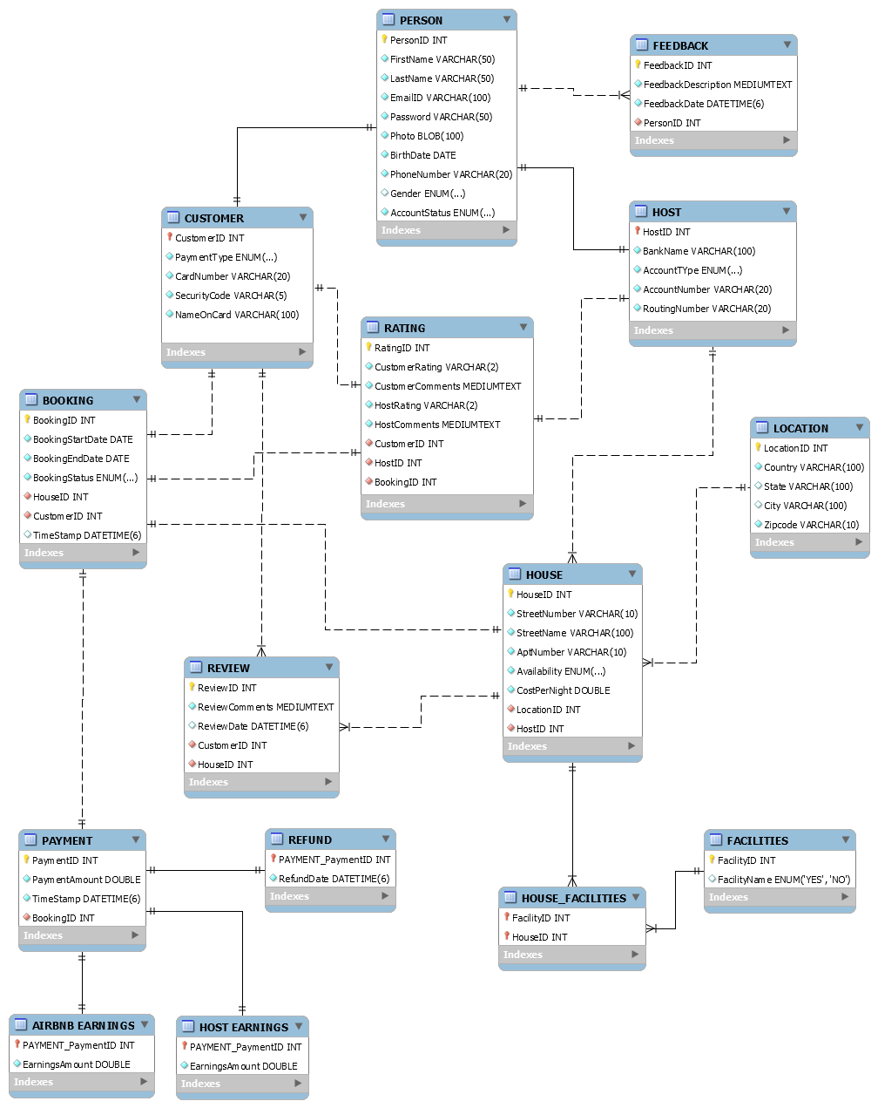

Slide 10
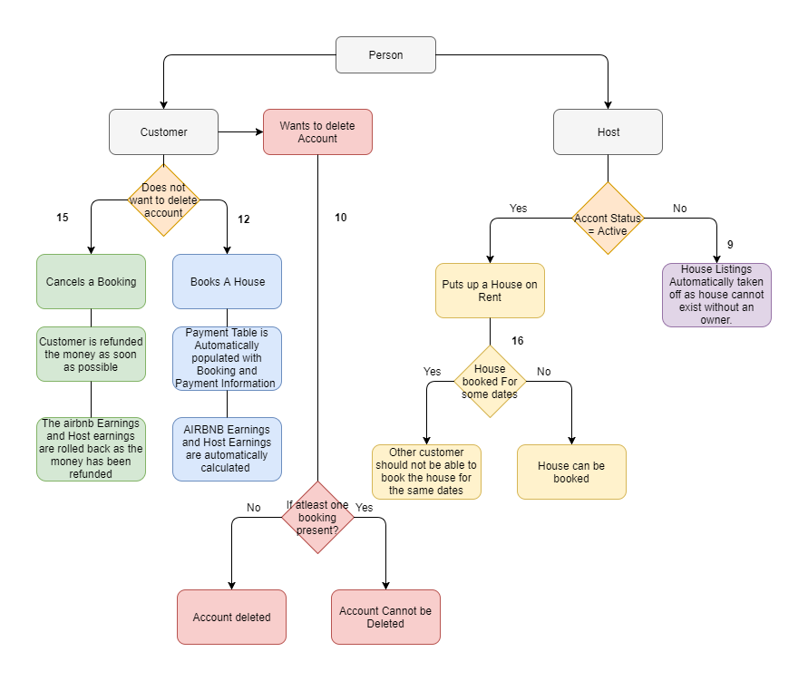

Slide 11
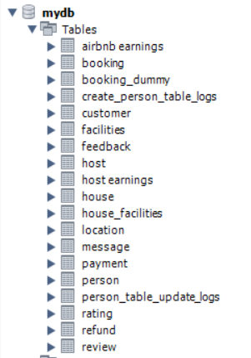
List of Tables :

Slide 12
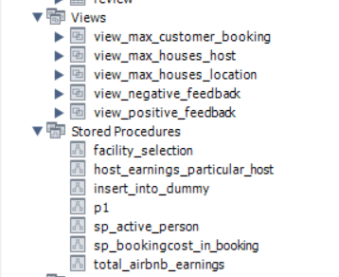
List of Stored Procedures and Views :

Slide 13
List of Triggers :
Booking_validation (booking)
Refund_policy (Booking)
Insert_into_paymenttable (booking_dummy)
Airbnb_trigger (payment)
Host_earnings_trigger (payment)
Delete_house_of_host (person)
Delete_customer_without_booking (person)
Create_person_record_logs (person)
Update_person_record (person)
Delete Airbnb_host_earnings (refund)

Slide 14
Workflows :
AIRBNB has a number of users which are either customers or hosts.
The customers select the location of their choice, the dates of their choice choice and book one of the houses that are listed.
Upon booking, the customer makes the payment out of which part of the payment goes to the AIRBNB enterprise and the other part goes to the Host whose house is been booked by the Customer.
Customers can book a house, cancel a booking and if a booking is cancelled then the payment is refunded.
Hosts can put up any number of houses on rent and can take them of anytime.

Slide 15
Scenarios :
Scenario 1 :
To check the way the encryption and image is stored in the DB.
Query :
Select * from person;

Slide 16
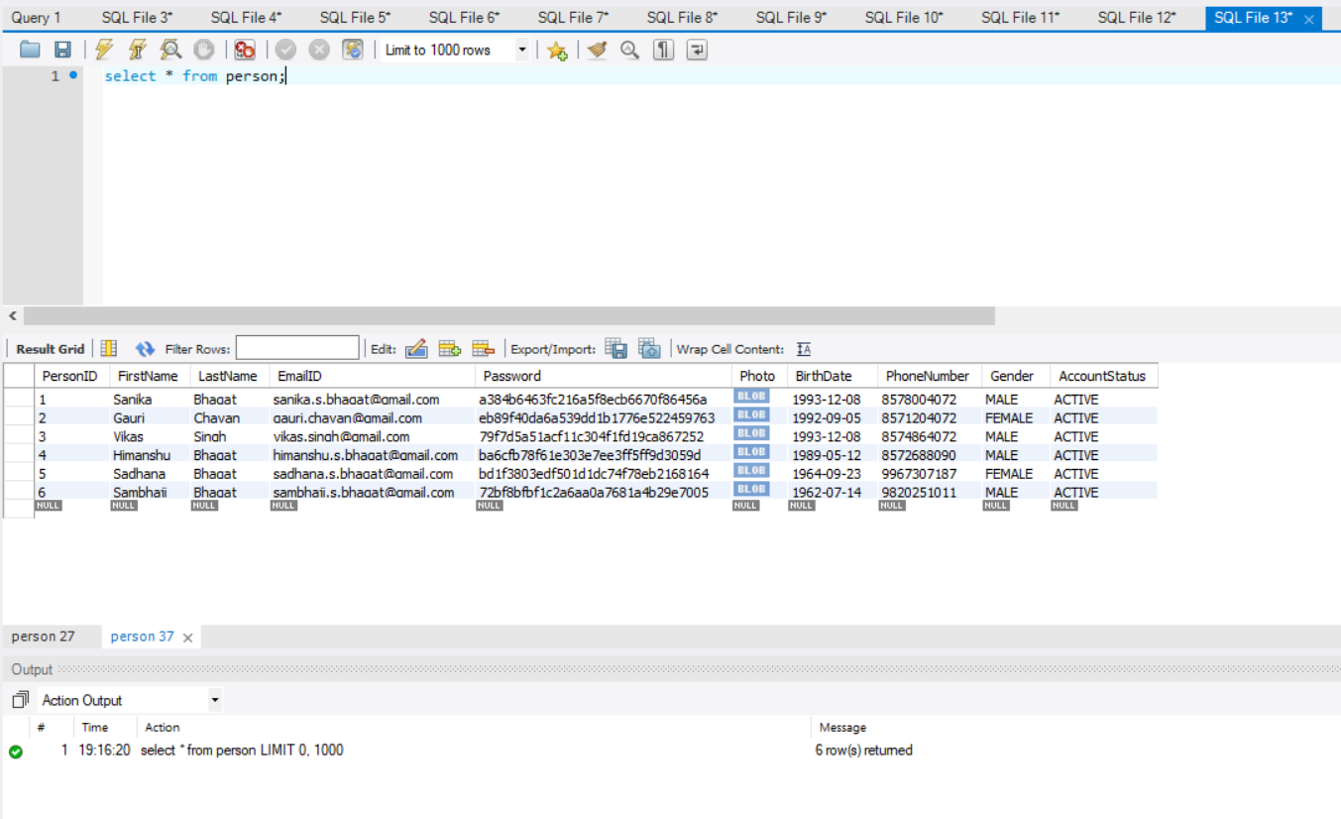

Slide 17
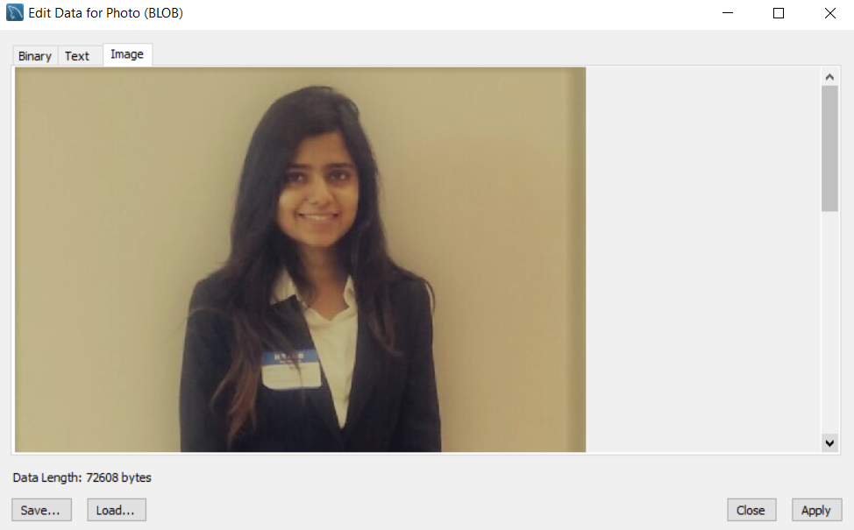

Slide 18
Scenarios :
Scenario 2:
Check how many Users are both Customers and Hosts with their contact information
Query :
select firstname as 'Person First Name', lastName as 'Person Last Name', emailID as 'Person Email ID', phoneNumber as 'Person Phone Number' from person where personID in (select customerID from customer where customerID in (select hostID from host where customerID=hostID));

Slide 19
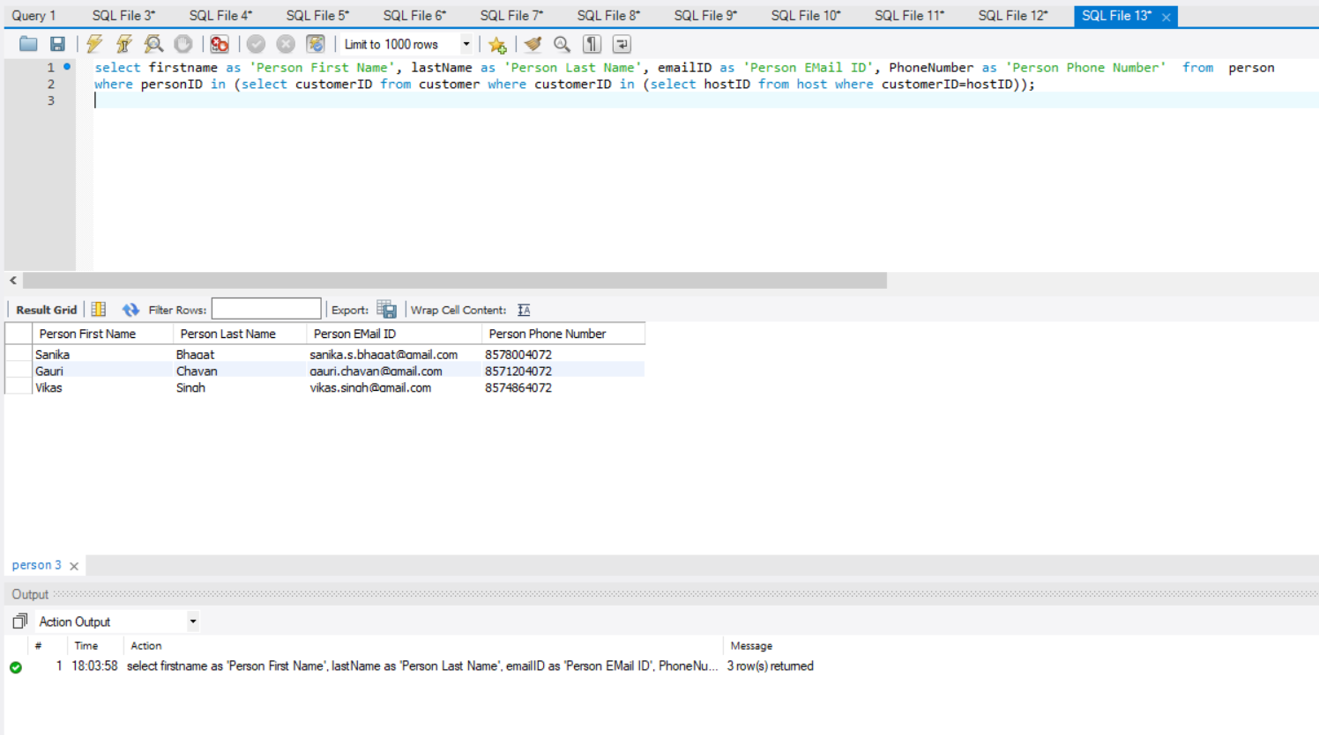

Slide 20
Scenarios :
Scenario 3 :
Find out the number of positive feedbacks received by AirBNB Enterprise.
Query :
create view view_positive_feedback
as
select * from feedback
where feedbackDescription like '%good%' or feedbackDescription like '%best%';
select * from view_positive_feedback;

Slide 21
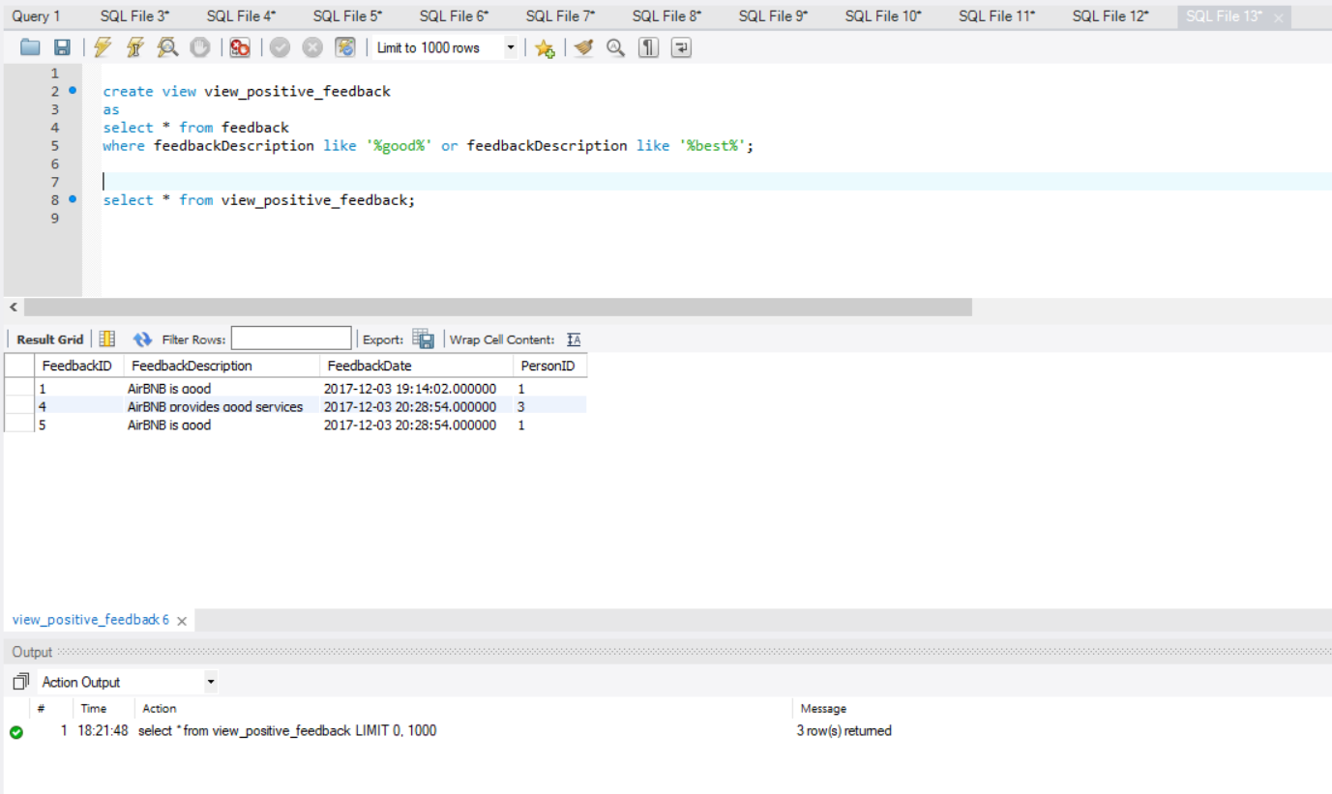

Slide 22
Scenarios :
Scenario 4 :
Find out the number of negative feedback received by AirBNB Enterprise.
Query:
create view view_negative_feedback
as
select * from feedback
where feedbackDescription like '%bad%' or feedbackDescription like '%worse%’;
select * from view_negative_feedback;

Slide 23
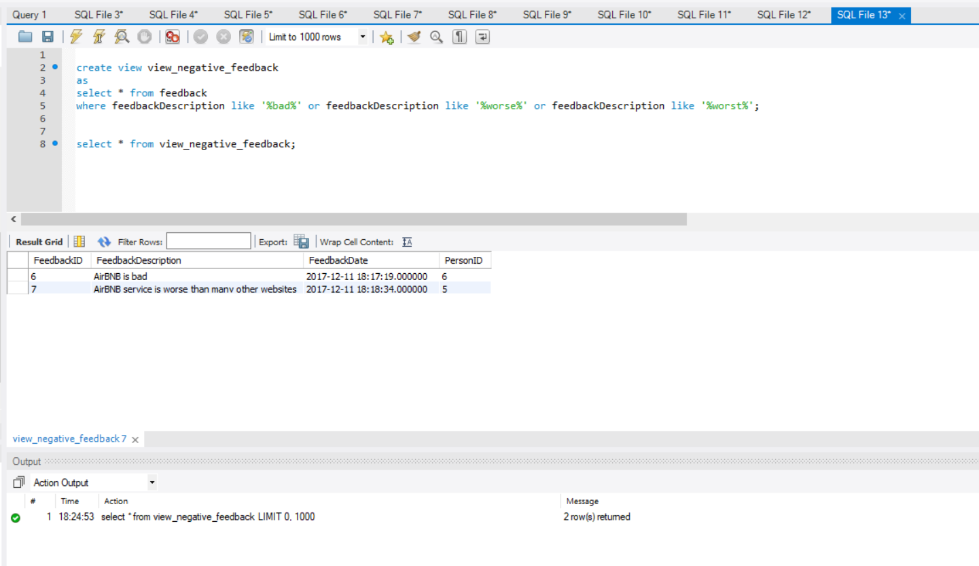

Slide 24
Scenarios :
Scenario 5 :
Find the Number of feedbacks given by each person to the AIRBNB enterprise.
Query :
SELECT feedback.personID, firstName,lastName, COUNT(*) as 'Number of Feedbacks' FROM feedback
inner join person
on person.personID=feedback.personID
GROUP BY personID
ORDER BY 'Number of Feedbacks' DESC;

Slide 25
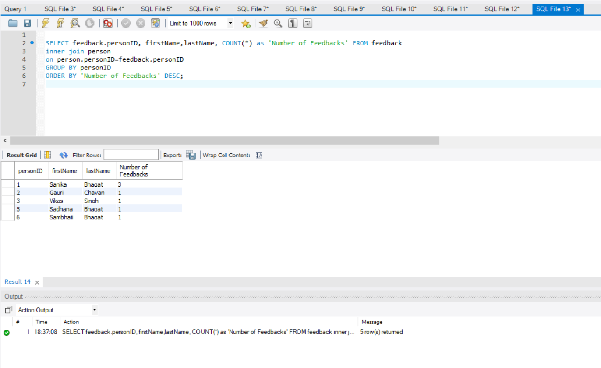

Slide 26
Scenarios :
Scenario 6 :
To find the number of houses in each location.
Query:
create view view_max_houses_location
as
SELECT house.LocationID, country,state, city, COUNT(*) as 'Number of Houses' FROM house
inner join location
on house.locationID=location.locationID
GROUP BY locationID
ORDER BY 'Maximum Houses';
select * from view_max_houses_location;

Slide 27
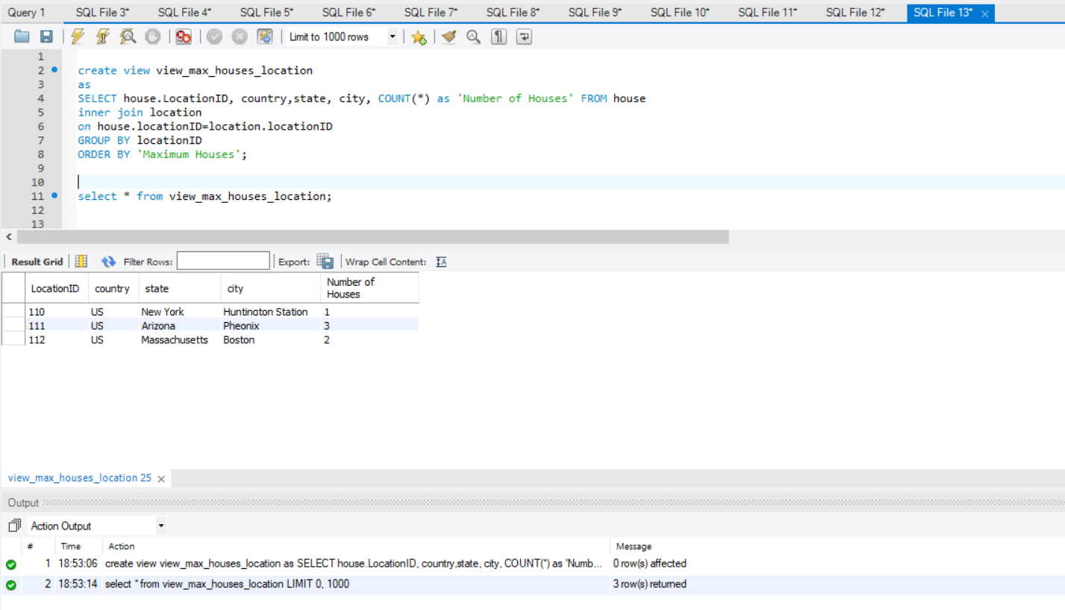

Slide 28
Scenarios :
Scenario 7 :
Find the host who has maximum number of houses put up on rent
Query :
create view view_max_houses_host
as
SELECT hostID, FirstName,lastName, COUNT(*) as NumberofHouses FROM house
inner join person
on house.hostID=person.personID
GROUP BY hostID
ORDER BY NumberofHouses desc
limit 1;
select * from view_max_houses_host;

Slide 29
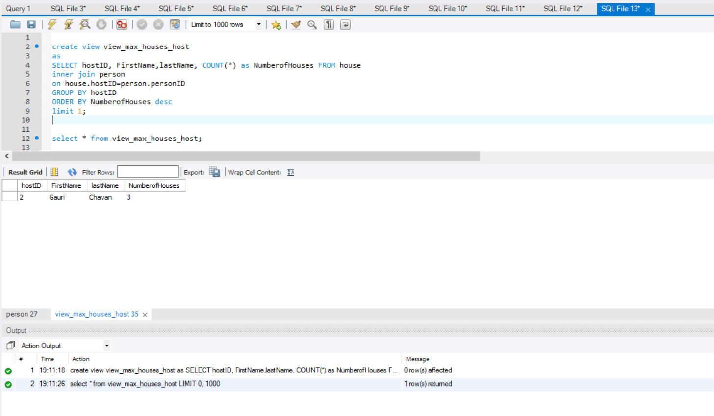

Slide 30
Scenarios :
Scenario 8 :
Find the Customer who has the highest number of bookings
Query :
create view view_max_customer_booking
as
SELECT PersonID, FirstName,lastName, count(*) as NumberofBookings FROM Booking
inner join Person
on Booking.CustomerID=person.personID
GROUP BY CustomerID
ORDER BY NumberofBookings desc;
select * from view_max_customer_booking;

Slide 31
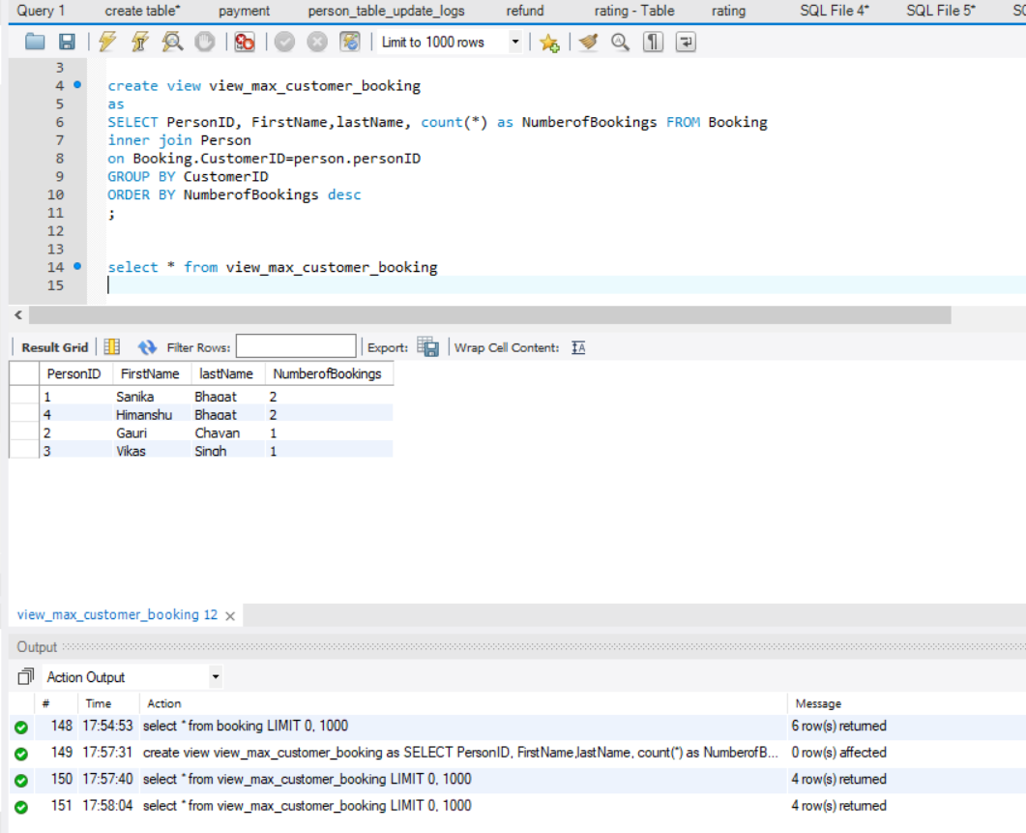

Slide 32
Scenarios :
Scenario 9 :
If person deactivates his account and if the person is a host, then the house listing posted by the host should be deleted.
Query :
create trigger delete_house_of_host
select * from house;
select * from person;
update person set accountStatus = 'inactive' where personId=3;
select * from person;
select * from house;

Slide 33
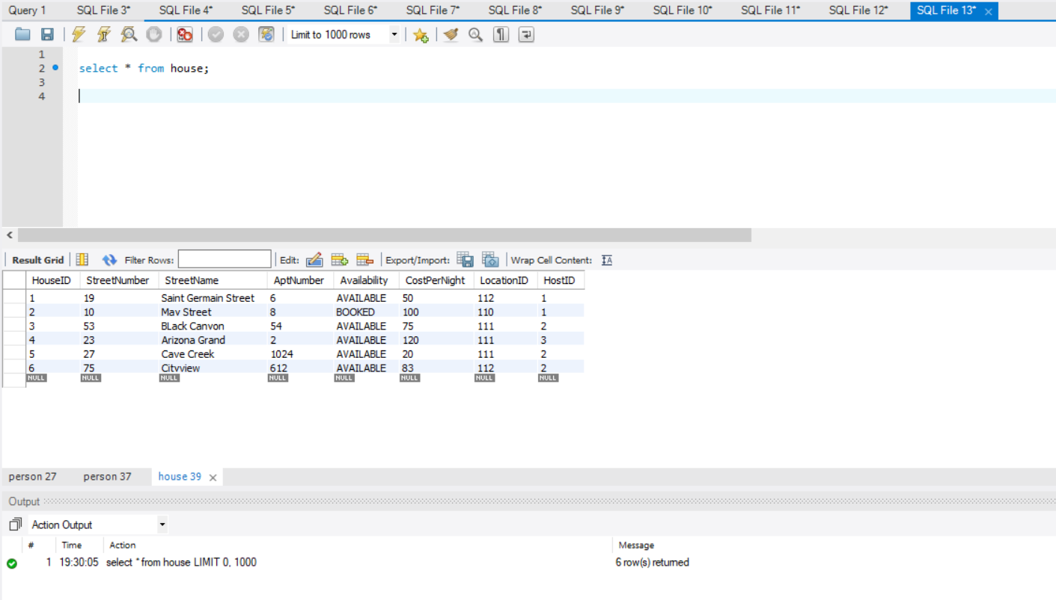

Slide 34
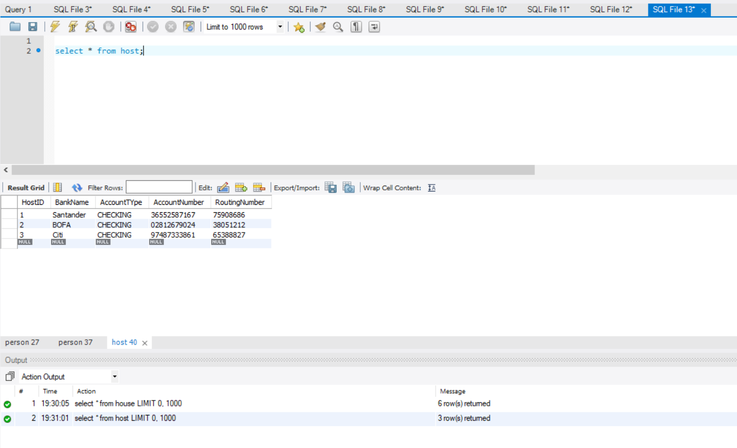

Slide 35
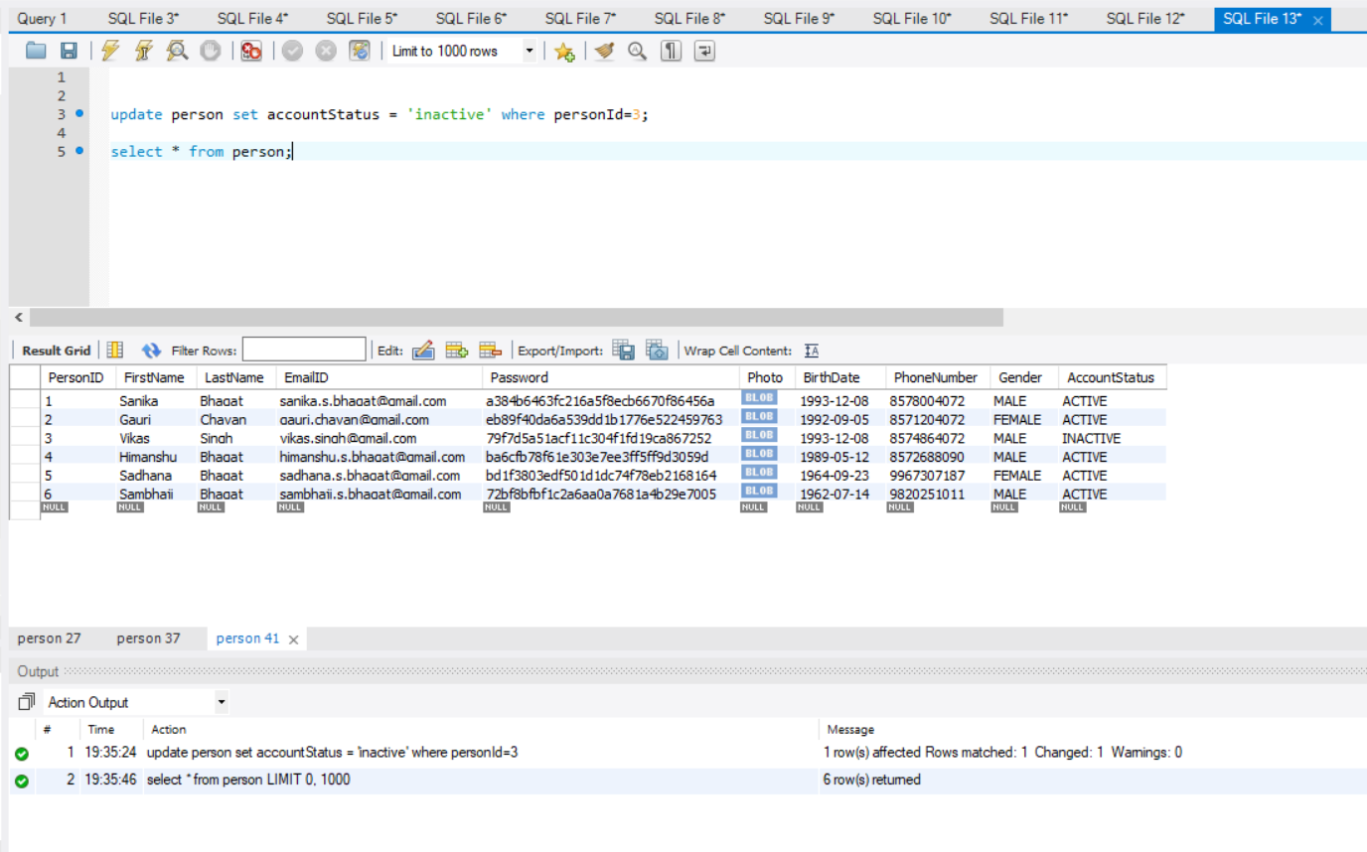

Slide 36
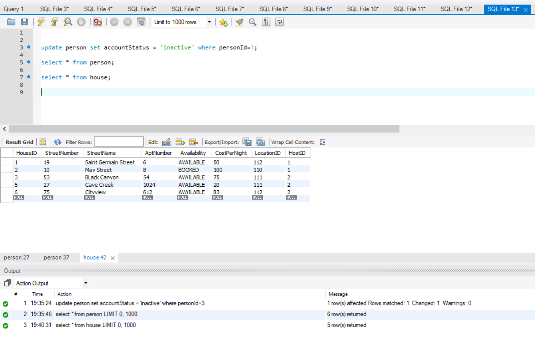

Slide 37
Scenarios :
Scenario 10 :
If a person wants to delete his account and the person is a customer, then he should not be able to delete his account if he has made atleast one booking .
Query :
create trigger delete_customer_without_booking
create table message
Select * from booking;
update person set accountStatus = 'inactive' where personId=3;
select messageName as 'Action' from message;
select * from person;

Slide 38
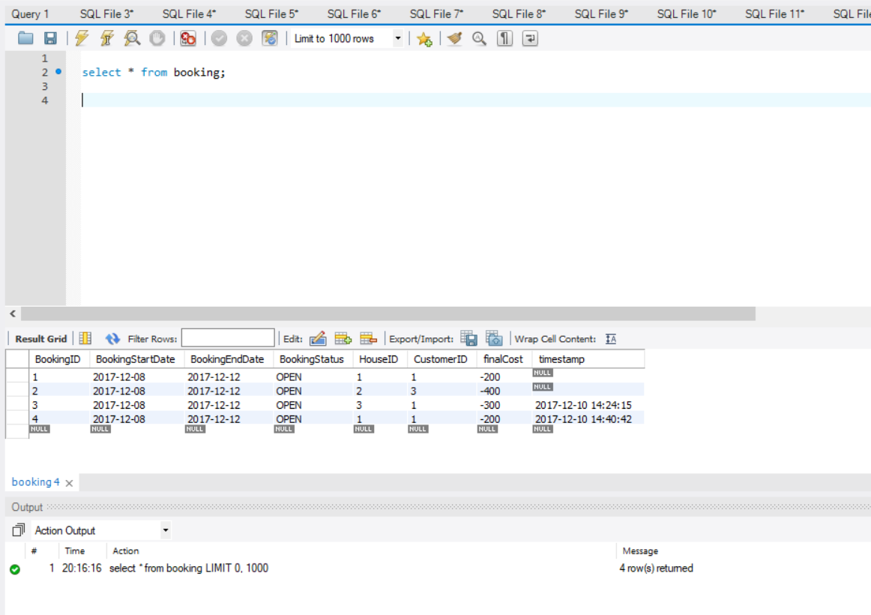

Slide 39
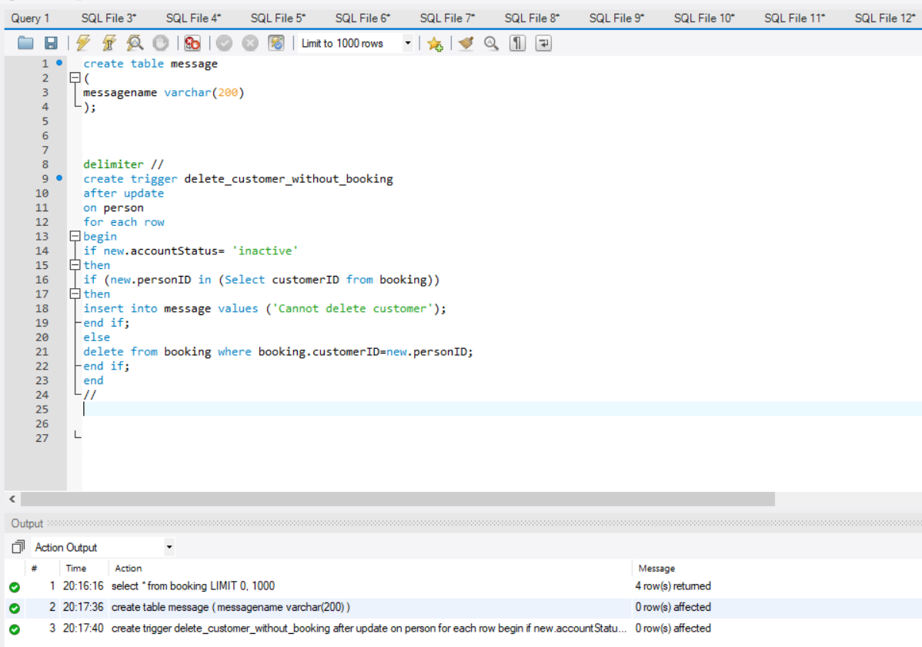

Slide 40
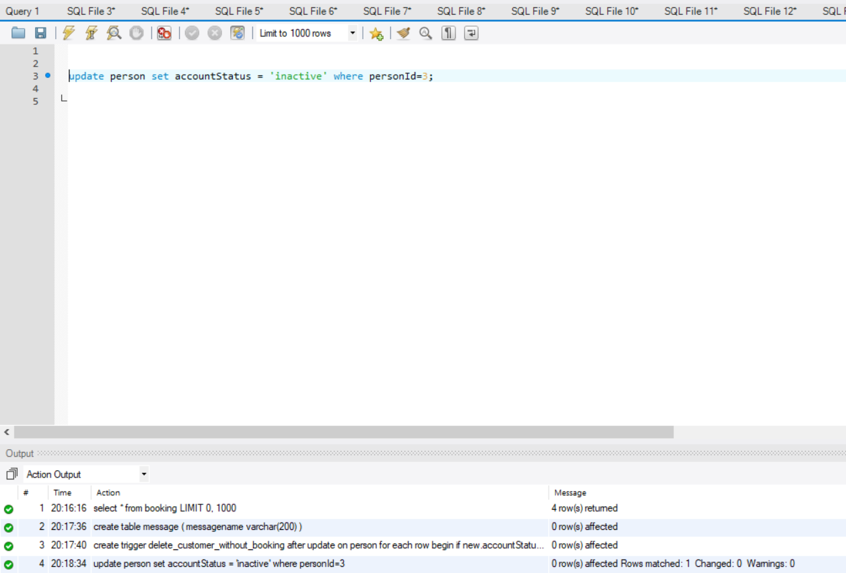

Slide 41
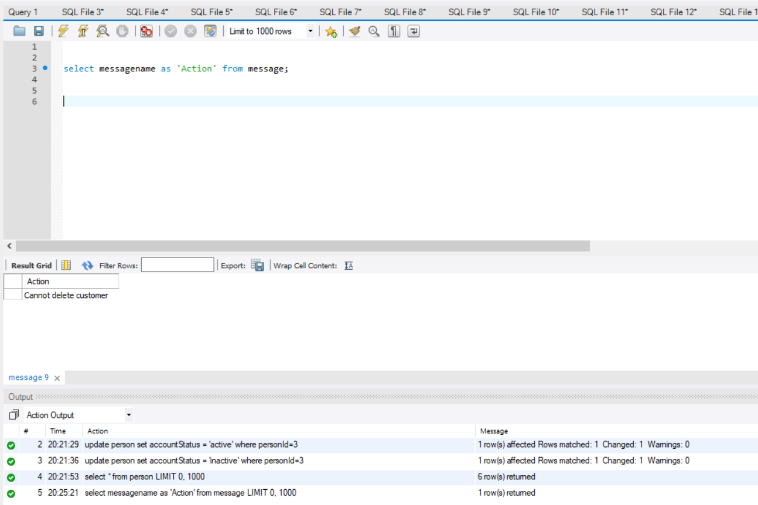

Slide 42
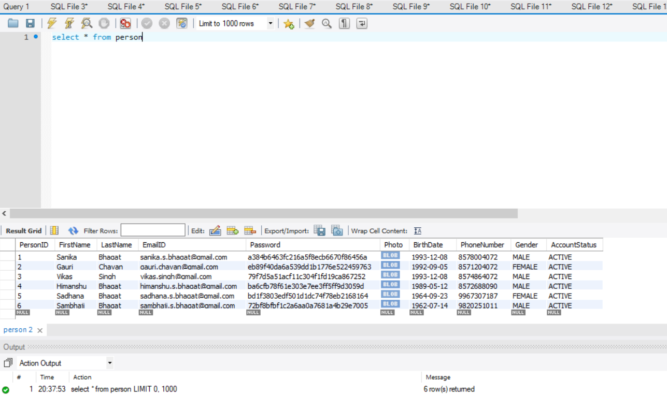

Slide 43
Scenarios :
Scenario 11 :
Suppose a person deleted his account and want to activate it again. Then a new row should not be created but the status of the person in the person table should be made active.
create procedure sp_active_person(in email varchar(200))
Select * from person
call sp_active_person('vikas.singh@gmail.com’);
Select * from person

Slide 45
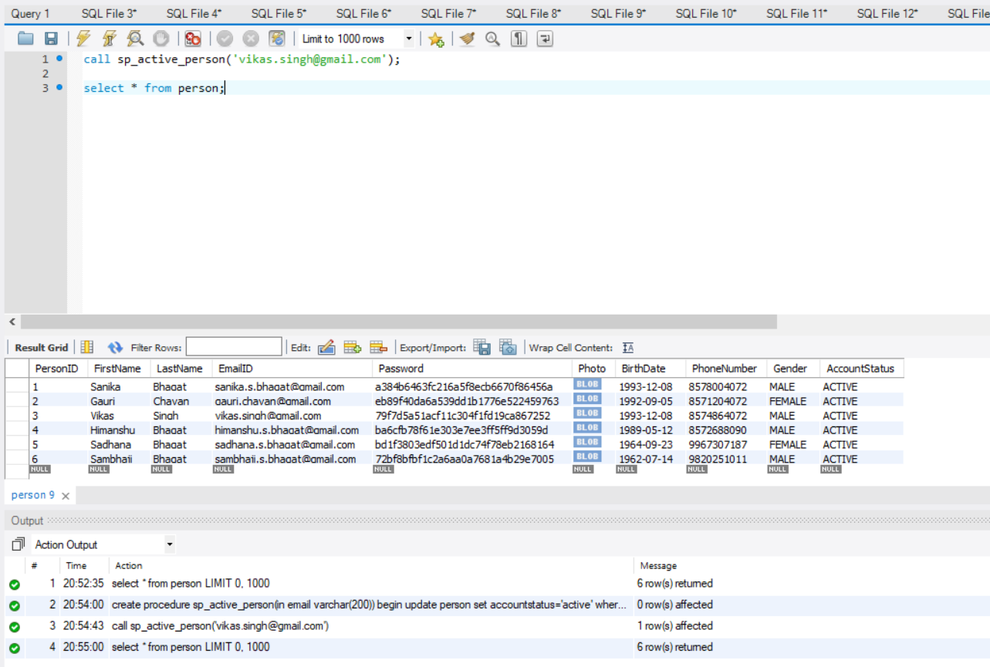

Slide 46
Scenarios :
Scenario 12 :
If a booking is done, the payment table should get populated and the after the payment table, the airbnb_earnings and host_earnings should be populated.
create procedure sp_bookingcost_in_booking ()
create table booking_dummy
create procedure insert_into_dummy()
create trigger insert_into_paymenttable
create trigger airbnb_trigger
create trigger host_earnings_trigger
insert into booking(bookingID,BookingStartDAte,BookingEndDate,BookingStatus,HouseID,CustomerID,timestamp) values (4,'2017-12-08','2017-12-12','OPEN','1','1',now());
call sp_bookingcost_in_booking();
call insert_into_dummy();

Slide 47
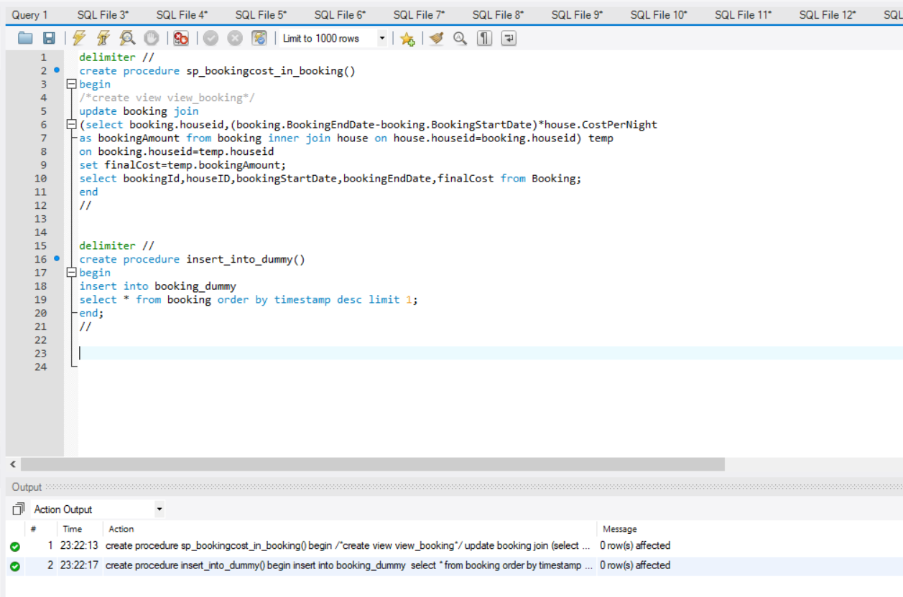

Slide 48
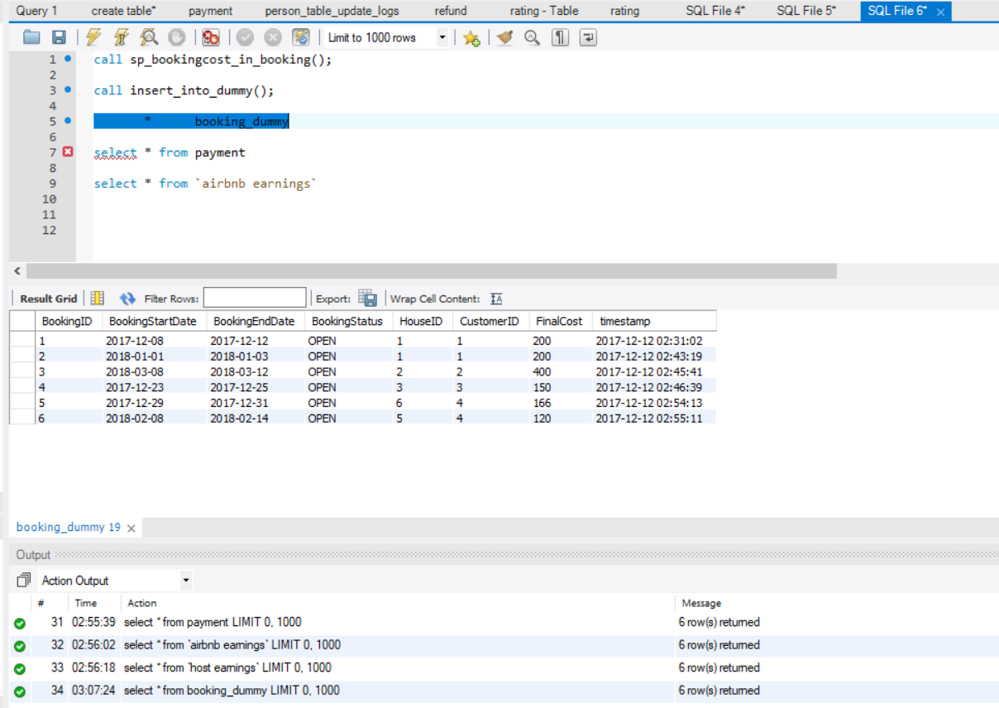

Slide 49
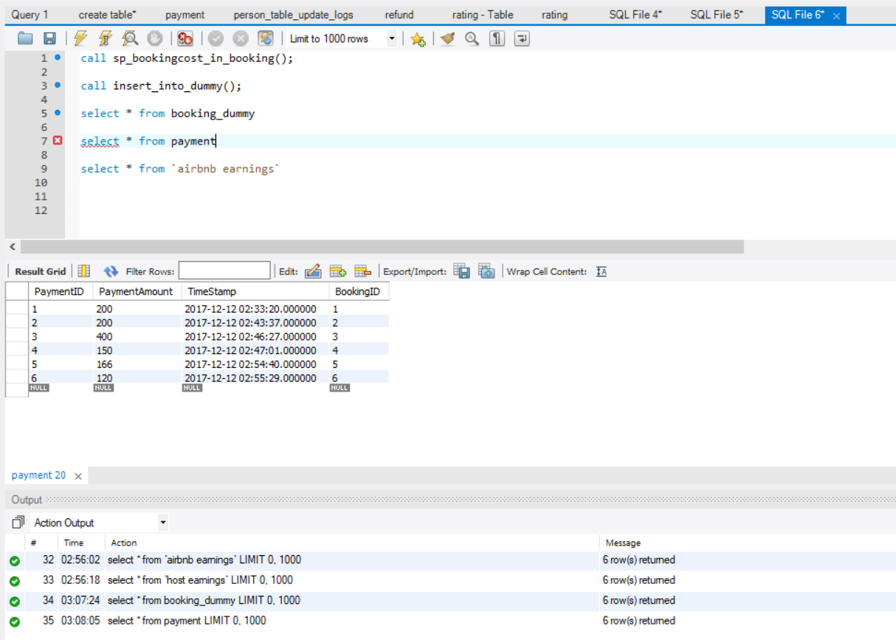

Slide 50
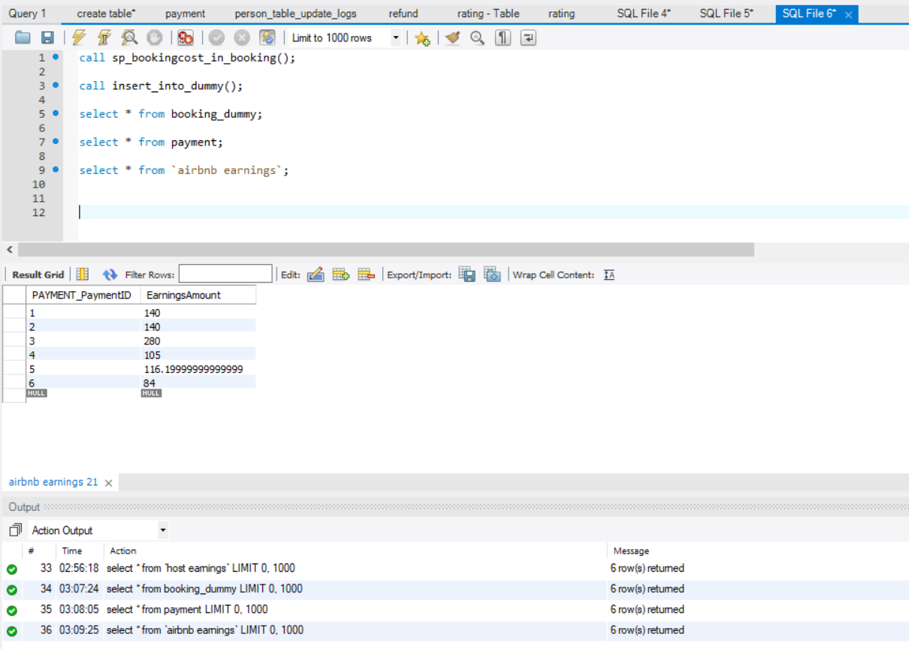

Slide 51
Scenarios :
Scenario 13:
Find out the total earnings of the host till date
Query :
create procedure host_earnings_particular_host(in hostID1 int)
call host_earnings_particular_host(1);

Slide 52
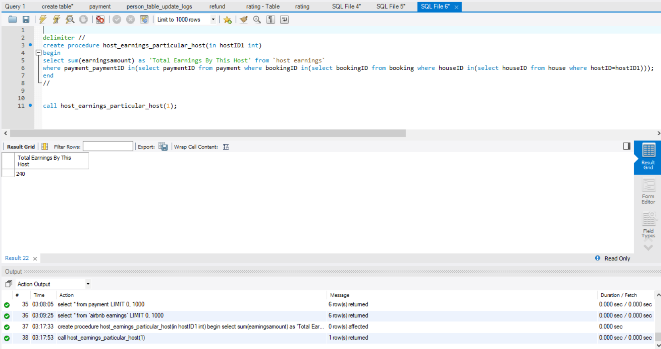

Slide 53
Scenarios :
Scenario 14 :
Find the total earnings of AIRBNB
Query :
delimiter //
create procedure total_airbnb_earnings()
select sum(EarningsAmount) as 'Total AirBNB Earnings' from `airbnb earnings`
end
//
call total_airbnb_earnings();

Slide 54
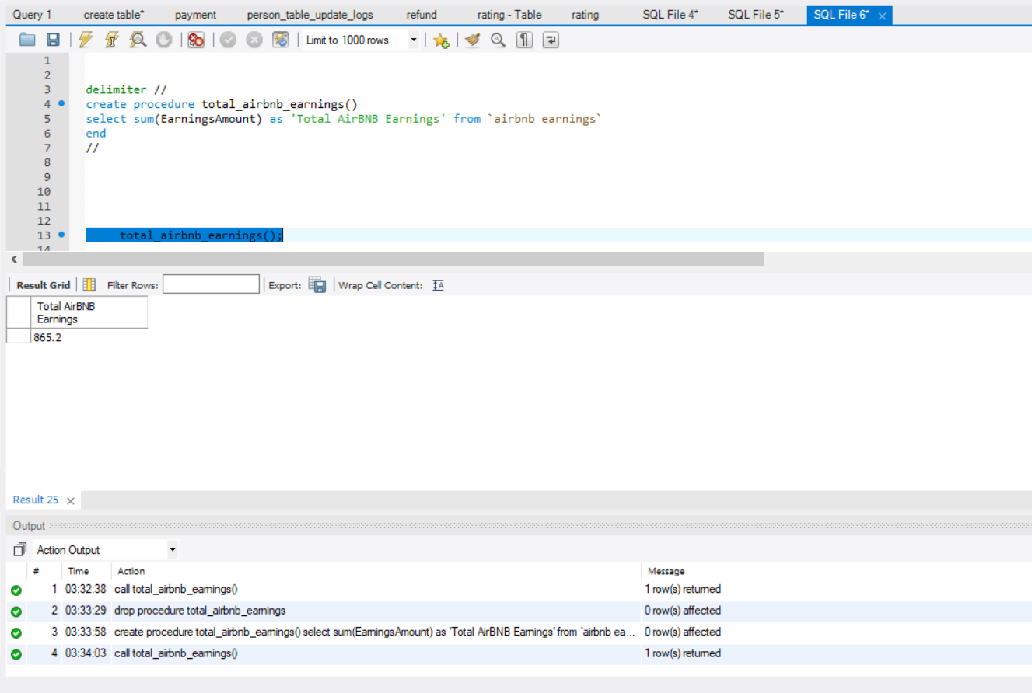

Slide 55
Scenarios :
Scenario 15 :
If a booking is cancelled, then the refund table should be populated and the records from airbnb and host tables should be deleted as well
Query :
create trigger refund_policy
create trigger delete_airbnb_host_earnings
select * from booking;
update booking set bookingStatus='cancelled' where bookingID=3;
select * from refund;
select * from `airbnb earnings`
select * from `host earnings`

Slide 56
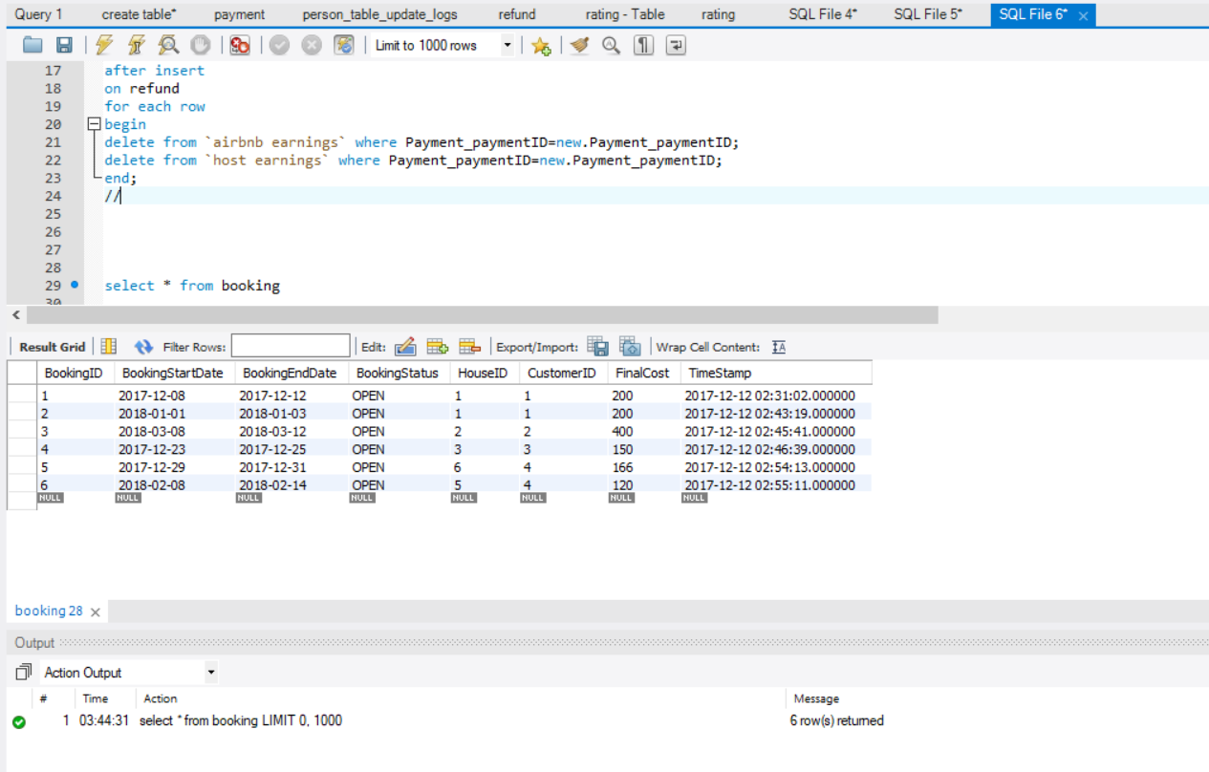

Slide 57
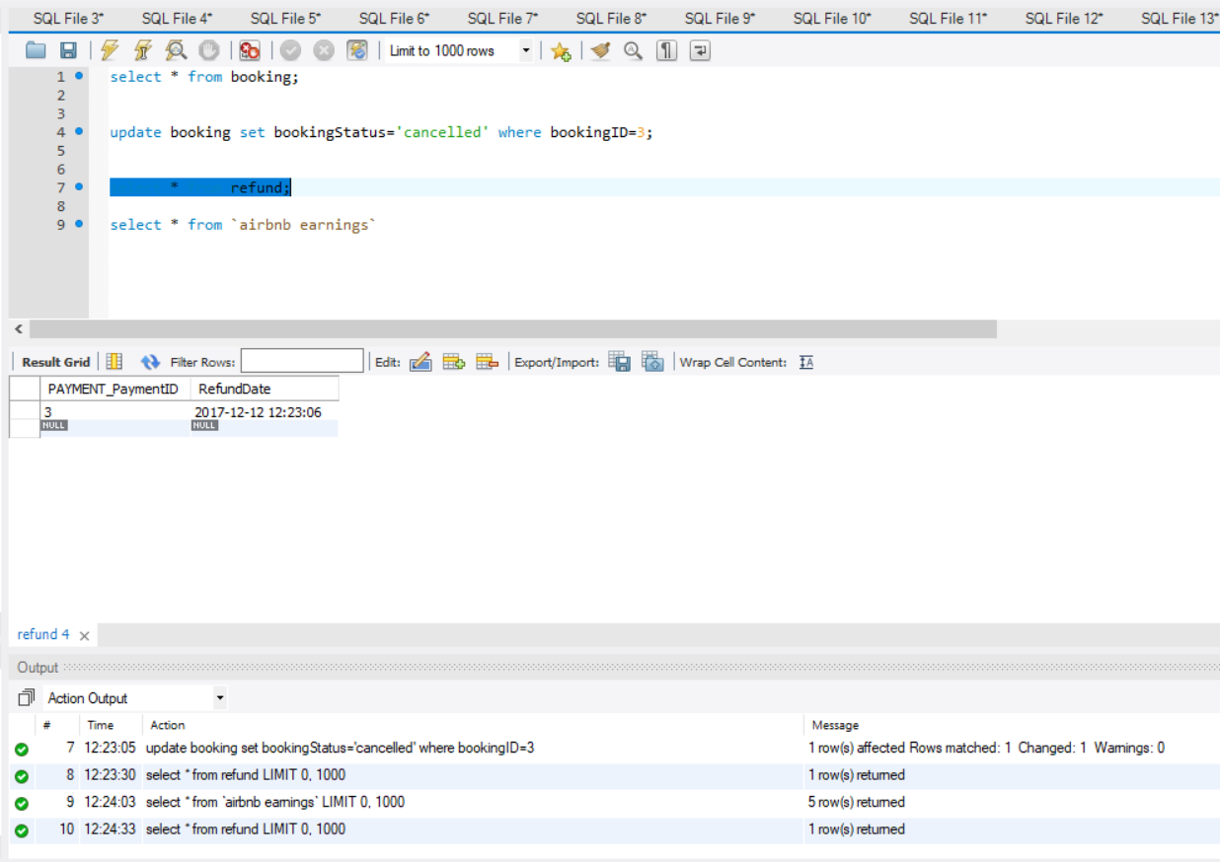

Slide 58
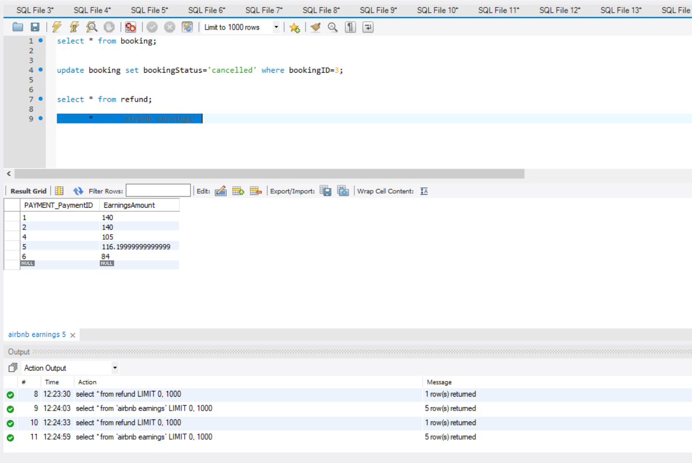

Slide 59
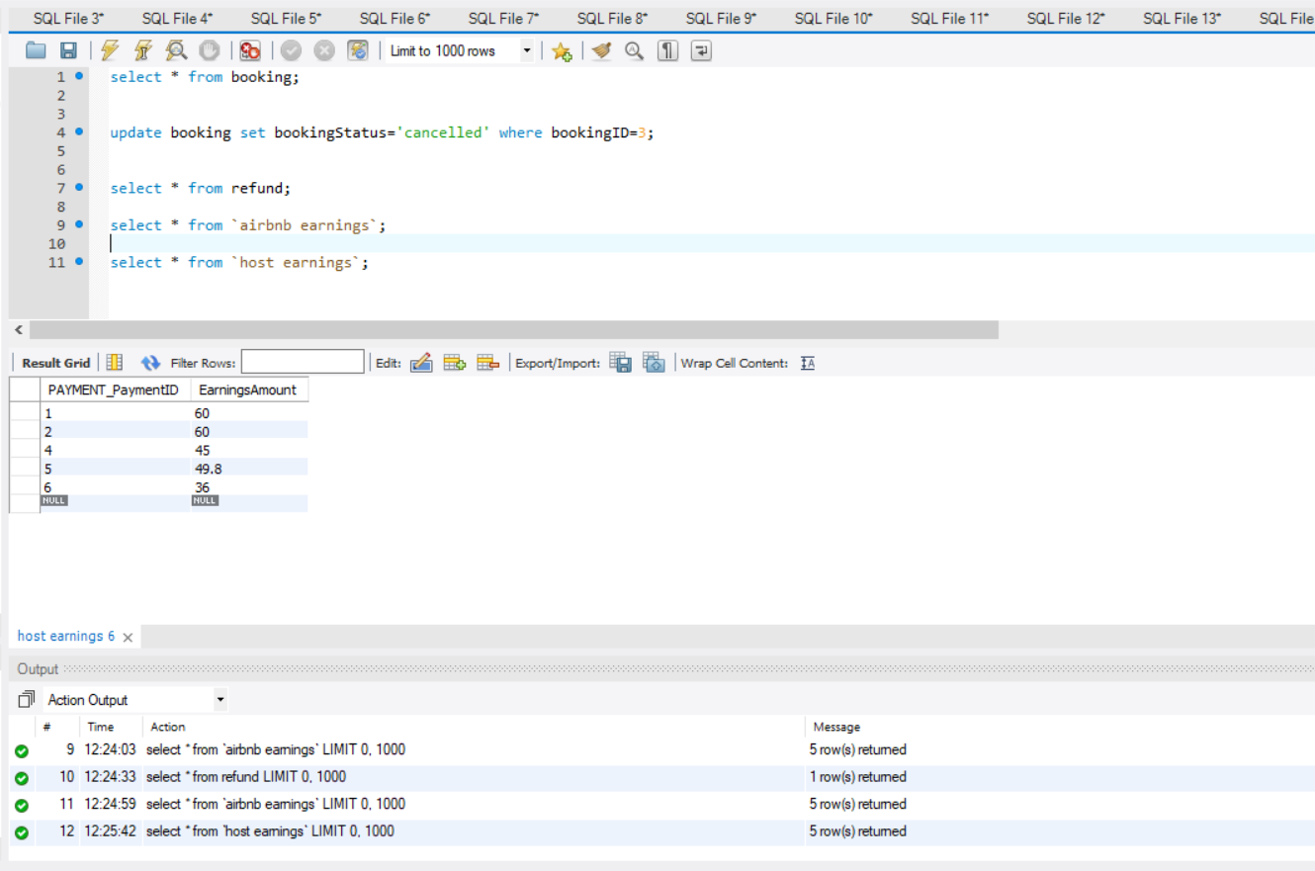

Slide 60
Scenarios :
Scenario 16 :
If a house has been booked for a number of days by a customer, the same house cannot be booked for the same number of days by any other customers.
Query :
create trigger booking_validation
create procedure p1()
select * from booking;
insert into booking values()
insert into booking(BookingID,bookingStartDate,BookingEndDate,bookingStatus,houseID,CustomerID,timestamp) values (7,'2017/12/24','2017/12/26','open',4,4,now());
call p1();

Slide 61
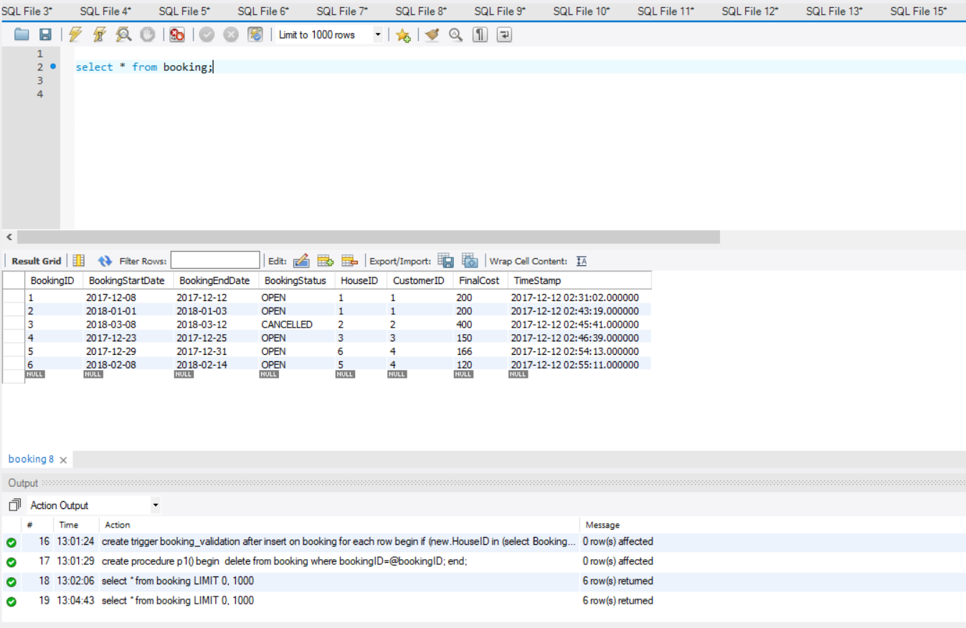

Slide 62
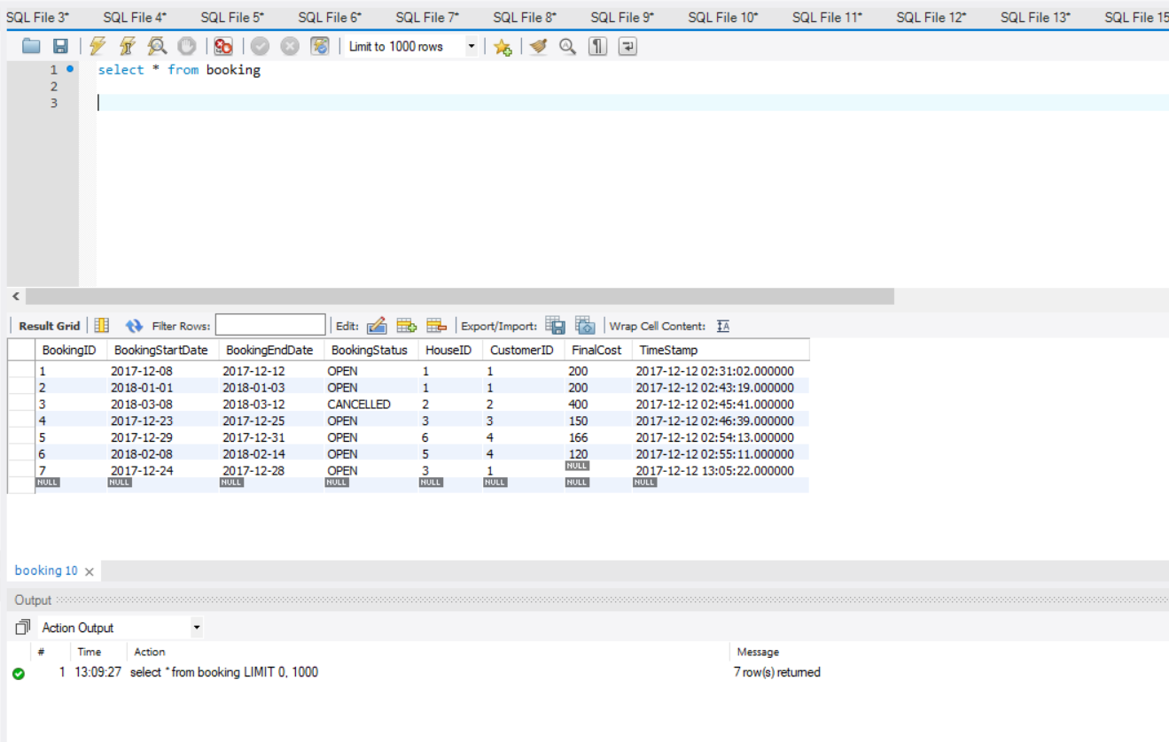

Slide 63
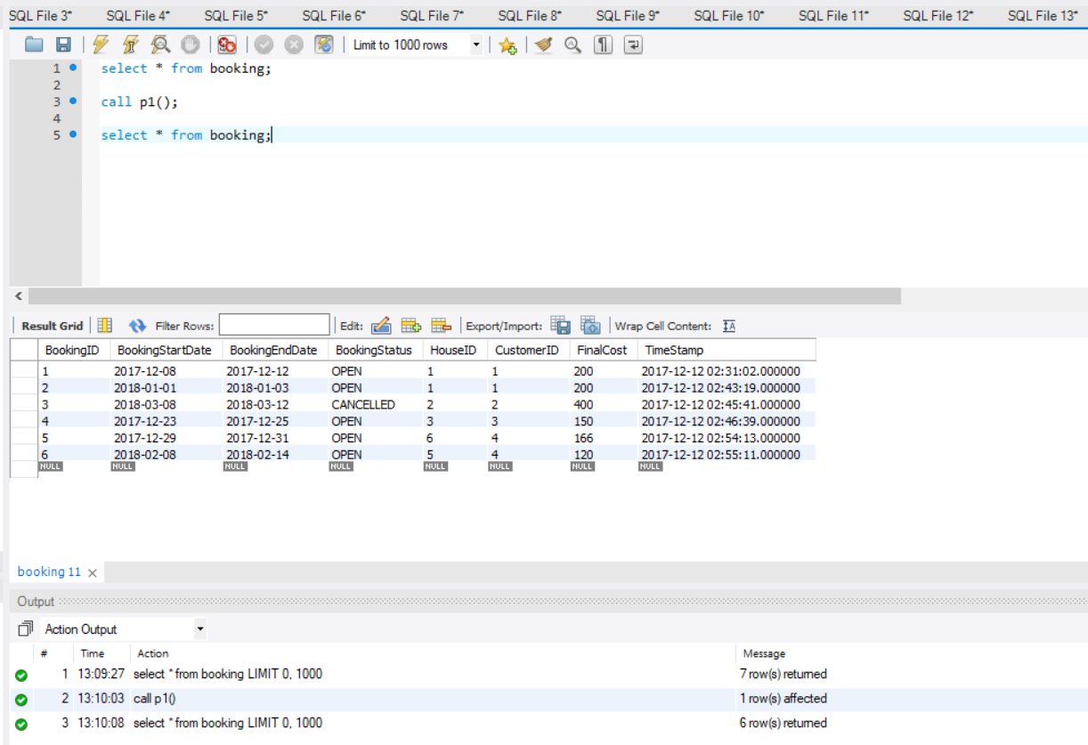

Slide 64
Scenarios :
Scenario 17 :
A person can choose whatever facilities he is looking for in a house and then the houses with only those facilities will be displayed to the user.
Query :
delimiter //
create procedure facility_selection(in facility1 varchar(20))
begin
select * from house
where houseID in (select houseID from house_facilities where facilityID = all(select facilityID from facilities where facilityName=facility1 ));
end //
call facility_selection('workspace');

Slide 65
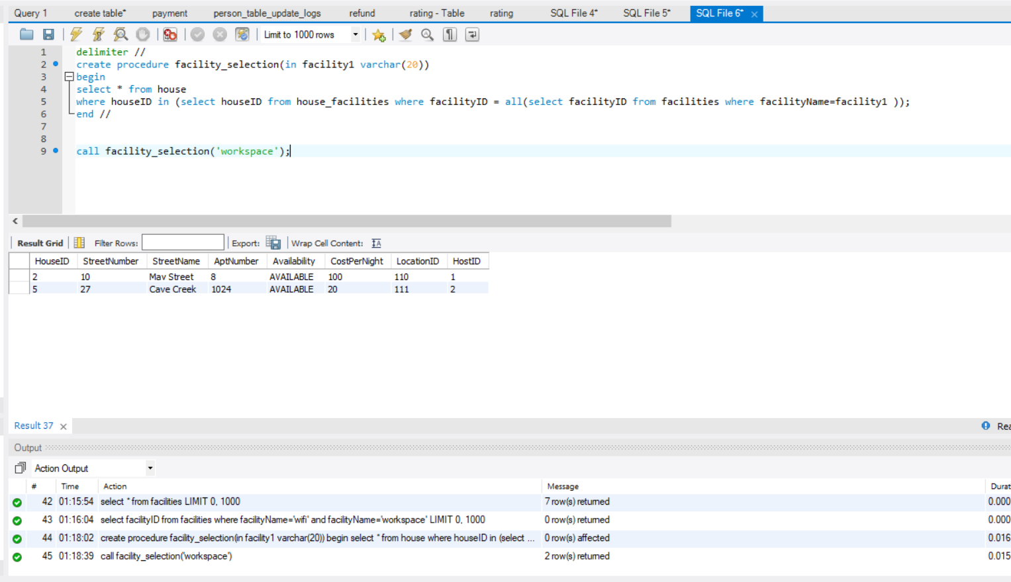

Slide 66
Scenarios :
Scenario 18 :
Find the house which has got the maximum reviews :
Query :
select * from review
select houseID,count(*) as 'count'from review
group by HouseID
order by count desc;

Slide 67
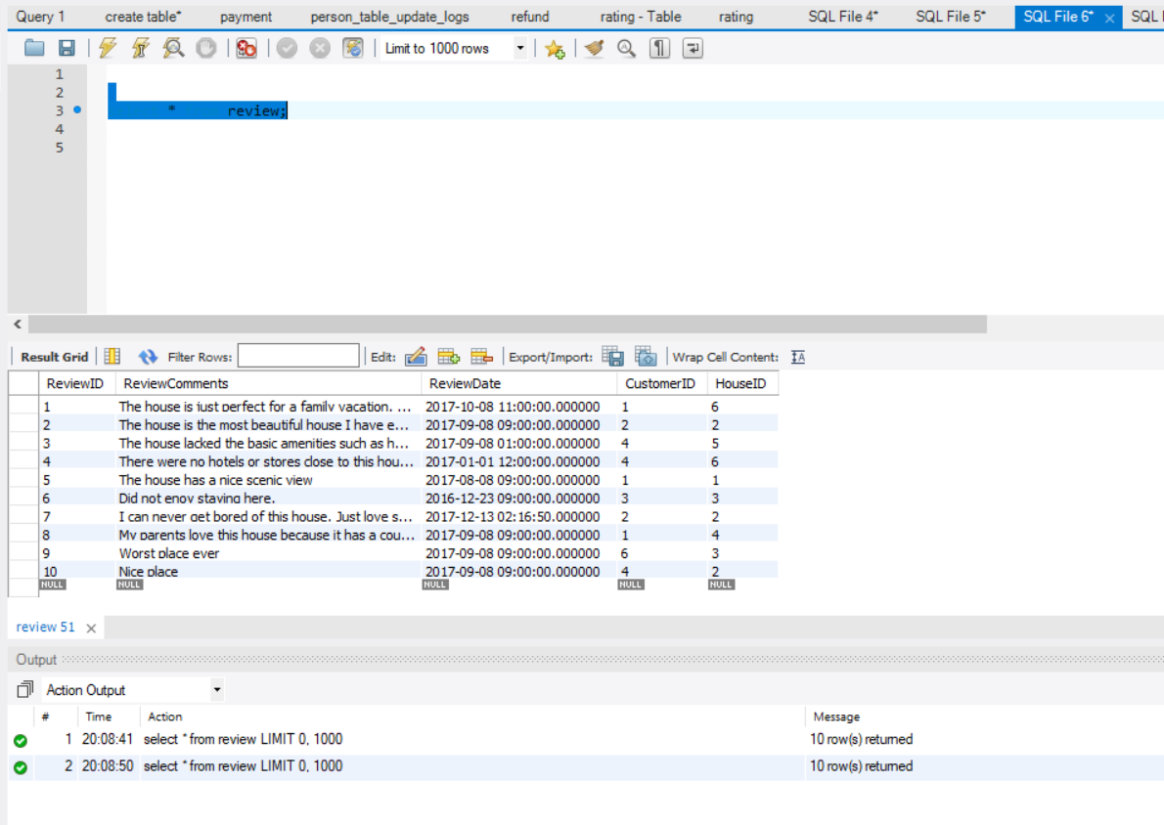

Slide 68
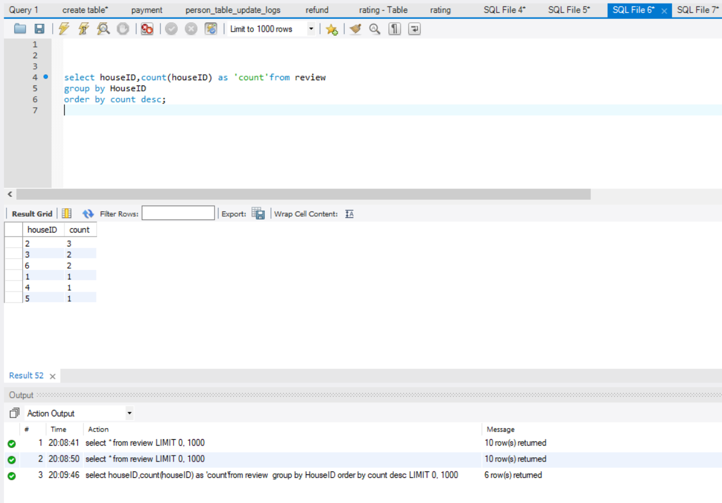

Slide 69
Scenarios :
Scenario 19 :
Find out the customers who have not written any reviews.
Query:
create view customer_not_written_review as
SELECT CUSTOMERID,FirstName,LastName FROM CUSTOMER AS C
inner join person as p
on c.customerID=p.personID
WHERE CUSTOMERID NOT IN (SELECT CUSTOMERID FROM REVIEW AS R);
Select * from customer_not_written_review;

Slide 70
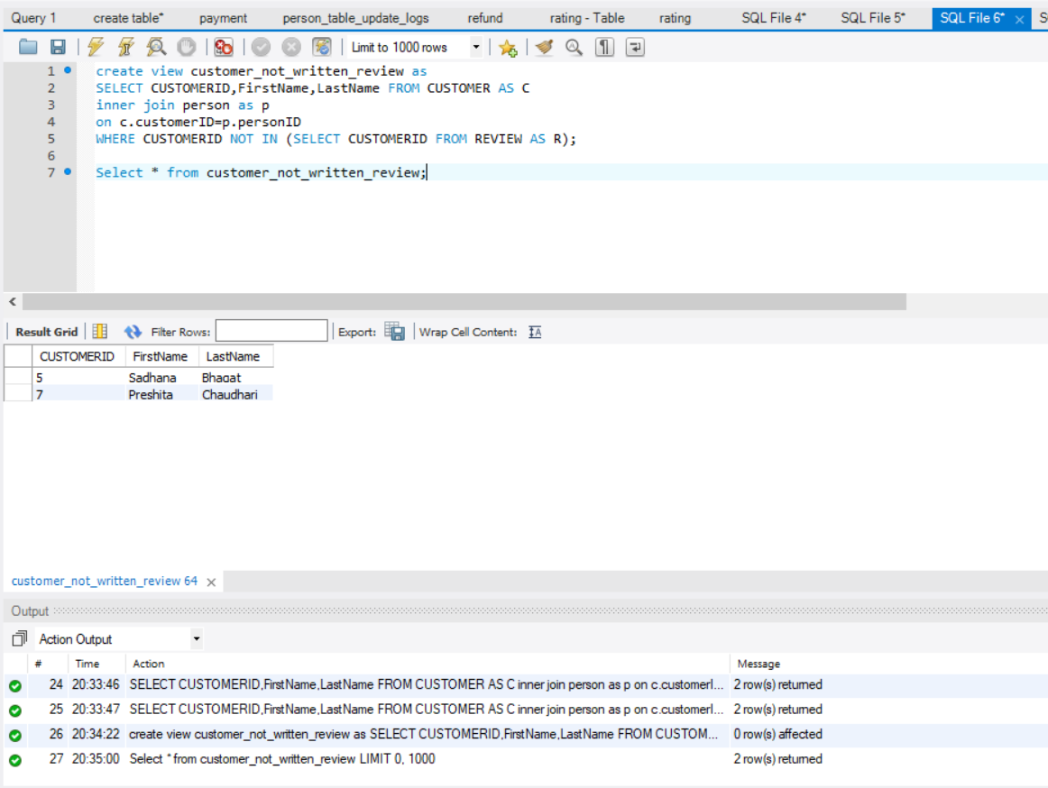

Slide 71
Scenarios :
Scenario 20 :
Find out the hosts who have received poor ratings from the customer.
Query :
create view host_bad_ratings_by_customer as
select rating.hostID, firstName, lastName, customerComments from rating
inner join person
on rating.hostID=person.personID
where customerRating<3;
select * from host_bad_ratings_by_customer;

Slide 72
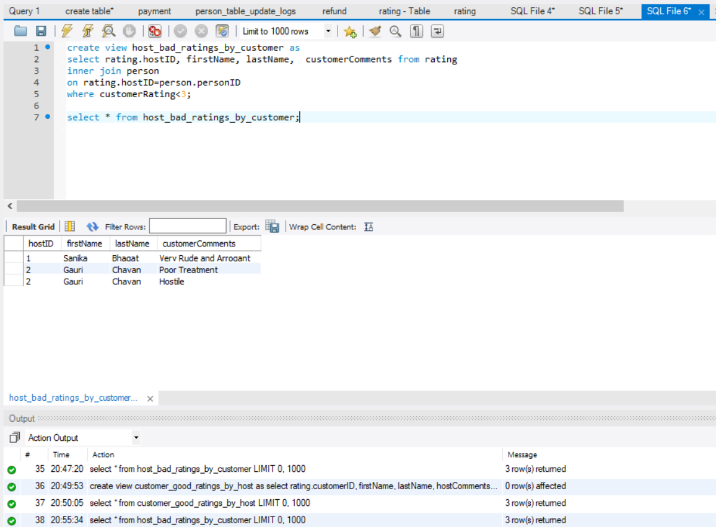

Slide 73
Scenarios :
Scenario 21 :
Find out the customers who have received good ratings from host.
Query :
create view customer_good_ratings_by_host as
select rating.customerID, firstName, lastName, hostComments from rating
inner join person
on rating.customerID=person.personID
where customerRating>2;
select * from customer_good_ratings_by_host;

Slide 74
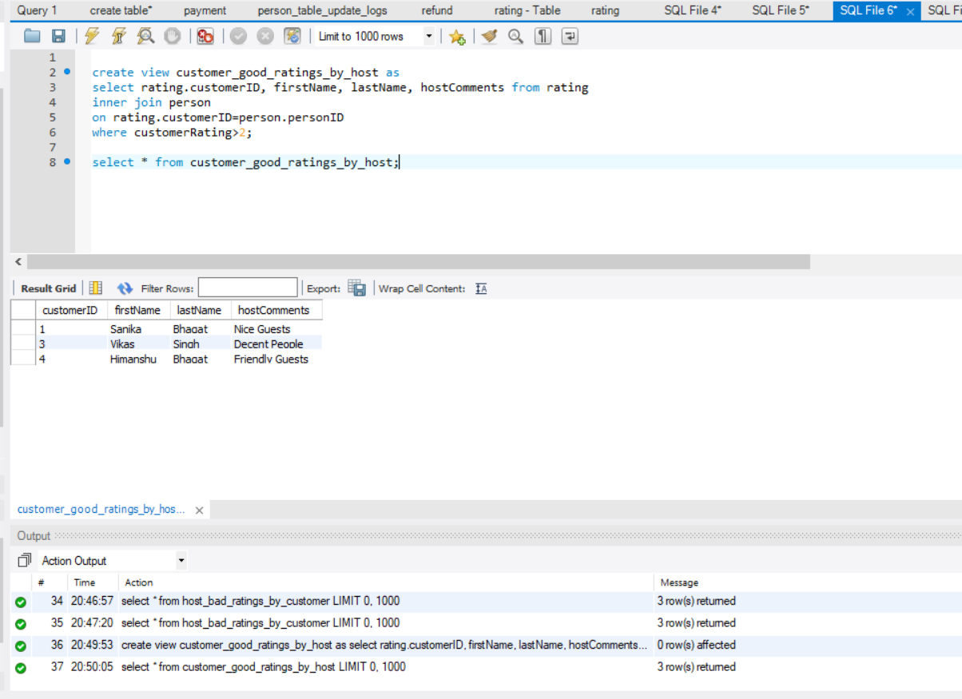

Slide 75
Log Tables :
Log Tables have been created to keep a record of the sensitive information of the organization and to track the changes made to any of the record.
The log Tables for the Person table are create_person_table_logs which will log any data entry into the Person table.
The second log table is the person_table_update_logs which will log the changes made to any of the record in the person table.
This table will keep the old value as well as the new value in the log table for reference.

Slide 76
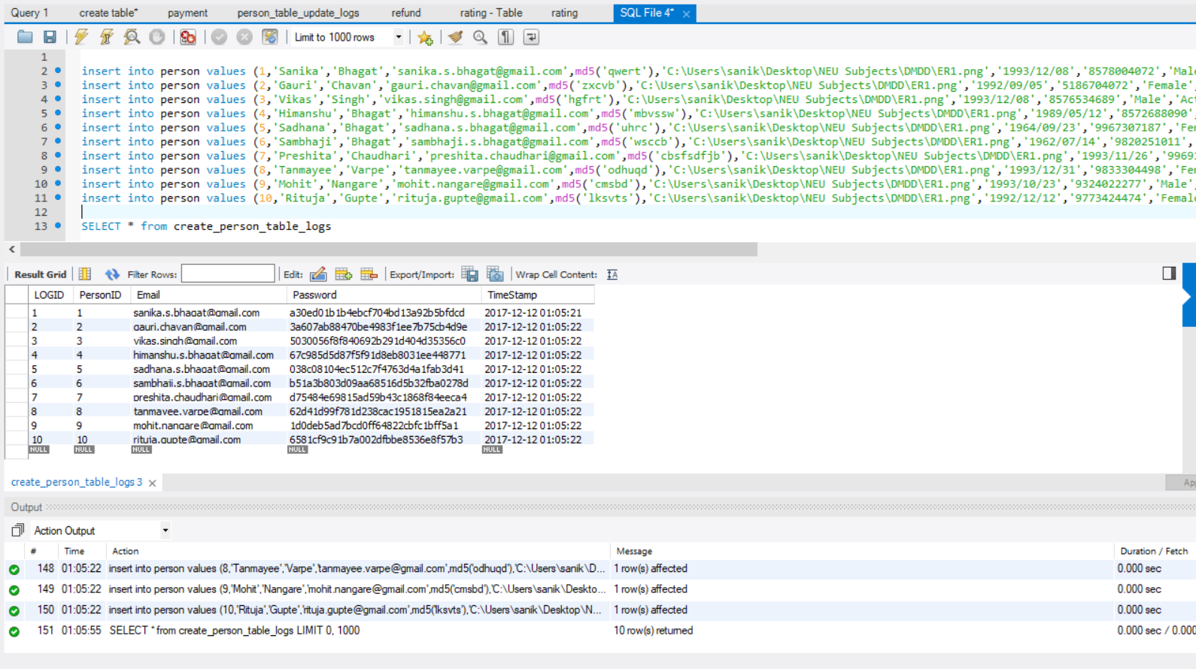

Slide 77
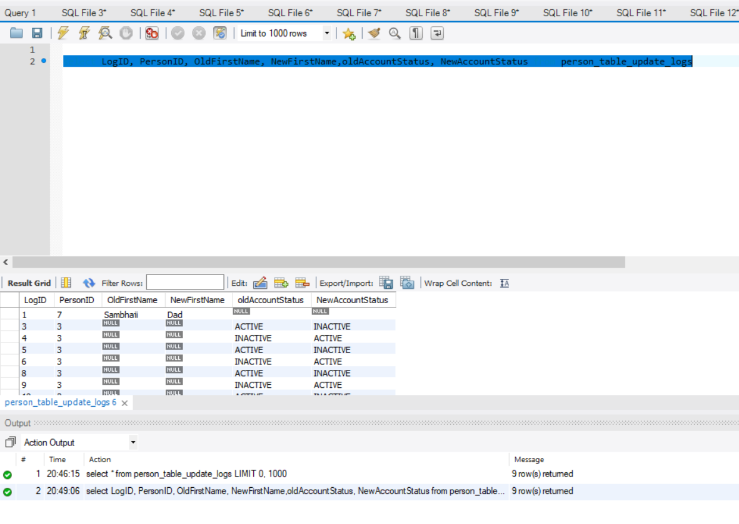

Slide 78
Users and Privileges :
The four Users of the AIRBNB Database John, Nicki, Sophia and Adam.
The users and created and they are identified by username and password.
create user 'John'@'localhost' identified by 'pass1'; /* Managing Director */
create user 'Nicki'@'localhost' identified by 'pass2'; /* Marketing Department Employee */
create user 'Sophia'@'localhost' identified by 'pass3'; /* Finance Department Head */
create user 'Adam'@'localhost' identified by 'pass4'; /* Finance Department Employee */

Slide 79
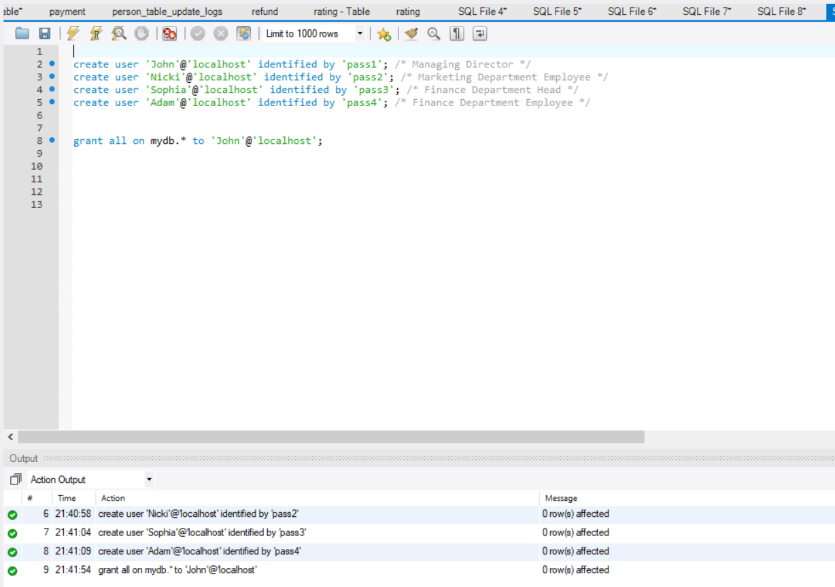

Slide 80
Granting Privileges :
grant select on mydb.Booking to 'Adam'@'localhost';
grant select on mydb.Refund to 'Adam'@'localhost';
grant select on mydb.Payment to 'Adam'@'localhost';
grant select on mydb.Booking to 'Sophia'@'localhost';
grant select on mydb.Refund to 'Sophia'@'localhost';
grant select on mydb.Payment to 'Sophia'@'localhost';
grant select on mydb.`airbnb earnings` to 'Sophia'@'localhost';
grant select on mydb.`host earnings` to 'Sophia'@'localhost';
grant select (personID,firstName,lastName,emailID,phoneNumber) on mydb.Person to'Sophia'@'localhost';
grant select on mydb.Review to 'Nicki'@'localhost';
grant select on mydb.Rating to 'Nicki'@'localhost';
grant select on mydb.Feedback to 'Nicki'@'localhost';
grant select (personID,firstName,lastName,emailID,phoneNumber) on mydb.Person to'Nicki'@'localhost'

Slide 81
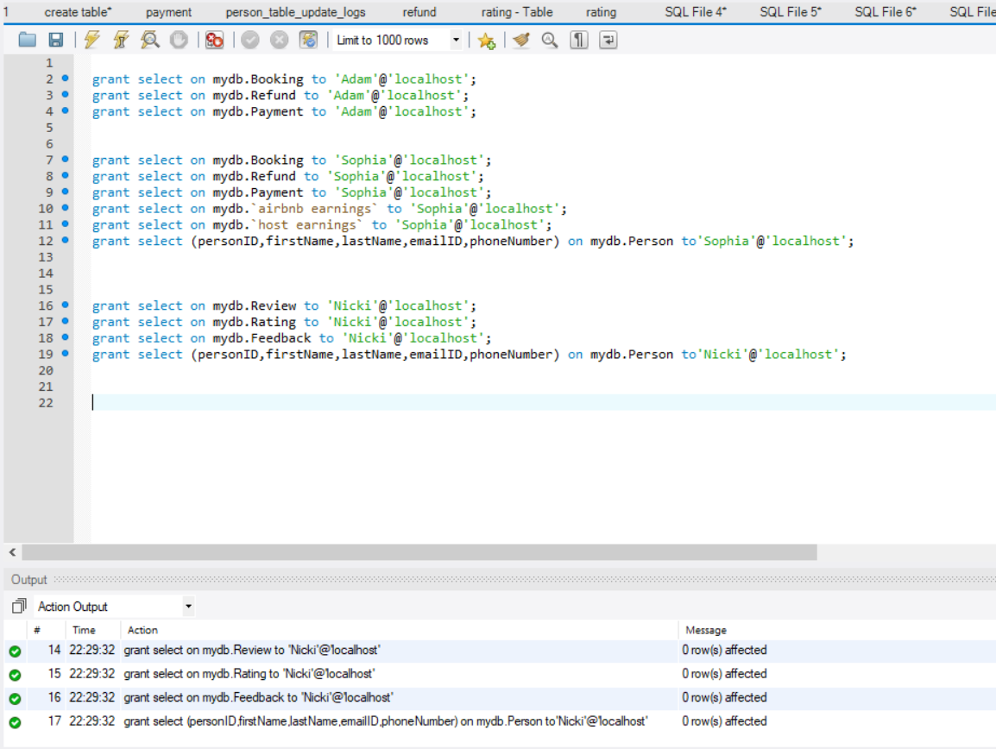

Slide 82
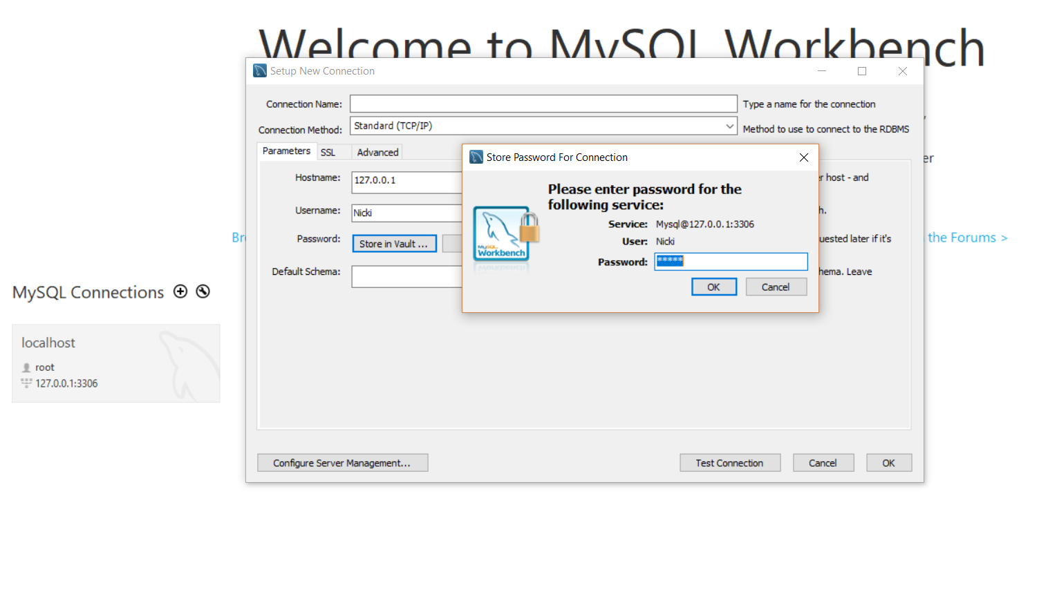
Login As a User :
Now when the Nicki logs in, her username and password is accepted.

Slide 83
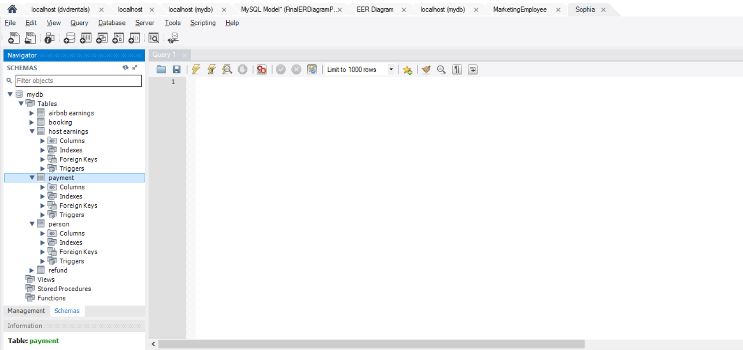
User Privileges and Column Privileges :
User Sophia can view the tables or the columns that they have been granted privilege on and can perform actions depending upon the privilege that they have been granted.

Slide 84
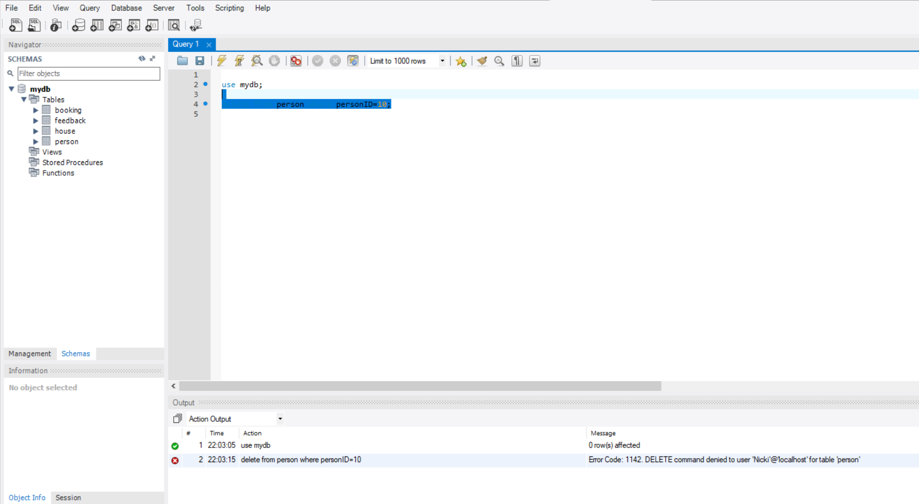
Deny Privileges :
If a user does not certain privilege, the permission is denied

Slide 85
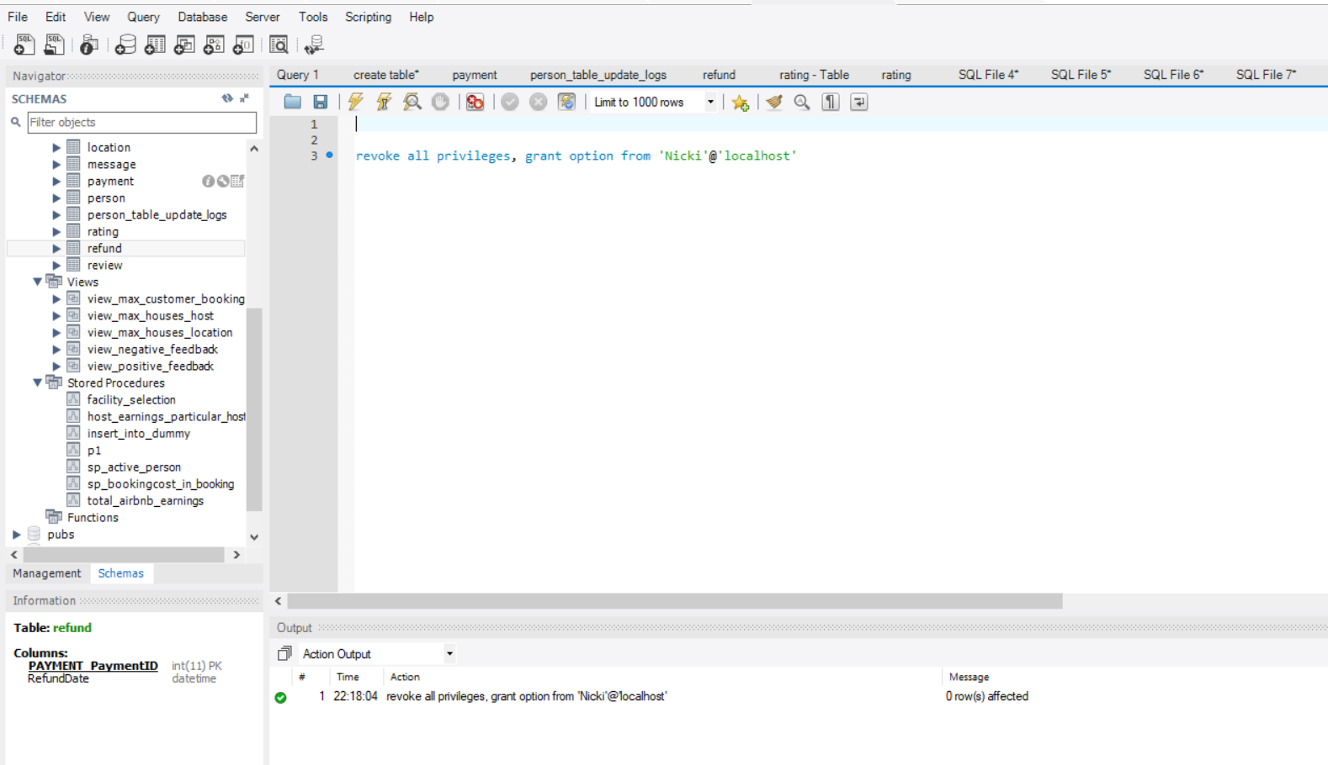
Revoke Privileges :
Privileges of Nicki are Revoked.

Slide 86

Login After Revoke Privileges :
After Nicki again logs in, she cannot see any tables.

Slide 87
Thank You !

